Slide 1

What is Framework ?
It is the semi implemented application which provides a good environment to develop the enterprise application as per developer convenience.
What is Spring Framework ?
Spring is a dependency injection java framework to make java applications loosely coupled. It makes easier to develop Java EE applications. Loose coupling is achieved using the concept of RTM(Runtime Polymorphism) and Has-A relationship.
It is open source framework to develop standalone and enterprise application.
Initial release was in 2003 under Apache 1.0 licence.
Production release i.e Spring 1.0 version was in 2004 by Rod Johnson.
Spring support AOP(Aspect Oriented Programming) programming paradigm or style.
Spring reduces Boiler-Plate Code. In computer programming, boilerplate code, or simply boilerplate, are sections of code that are repeated in multiple places with little to no variation.
We use Unit-Testing method to test applications developed using spring.
Spring allows developers to use POJOs(Plain old java object) to create enterprise-class apps.
The Spring framework can be considered as a collection of sub-frameworks, also referred to as layers, such as Spring AOP, Spring ORM, Spring Web Flow, and Spring Web MVC. You can use any of these modules separately while constructing a Web application. The modules may also be grouped together to provide better functionalities in a web application.

Slide 2
Remember this during java project and maven project
In normal Java projects, we have to download the JAR file manually.
spring-beans.xxx.jar, spring-core.xxx.jar, spring-context.xxx.jar, commons-logging.xxx.jar, spring-expression.xxx.jar these jar files has to be downloaded manually. Here xxx determines the version.
But when we create a Maven project, we provide dependencies through which JAR files are automatically downloaded. We don't need to download the JAR files manually and add them in the project.
Steps to close the ApplicationContext Object
Type Cast the ApplicationContext Object to ConfigurableApplicationContext object.
Then call the close object on that, i.e ((ConfigurableApplicationContext)context).close();
How to push Eclipse code to GitHub : https://www.youtube.com/watch?v=B2N1AKIQfnY
8080 🡪 Default port for Tomcat Server.
@Data 🡪 To use Lombok(automatically creates getter, setter, hashCode() and equals()).
Get the overridden methods in your class → source > Override/Implement method > select the method you want.
To ignore the warning in pom.xml → <!--$NO-MVN-MAN-VER$-->
Database Output → http://localhost:8080/h2-console

Slide 3
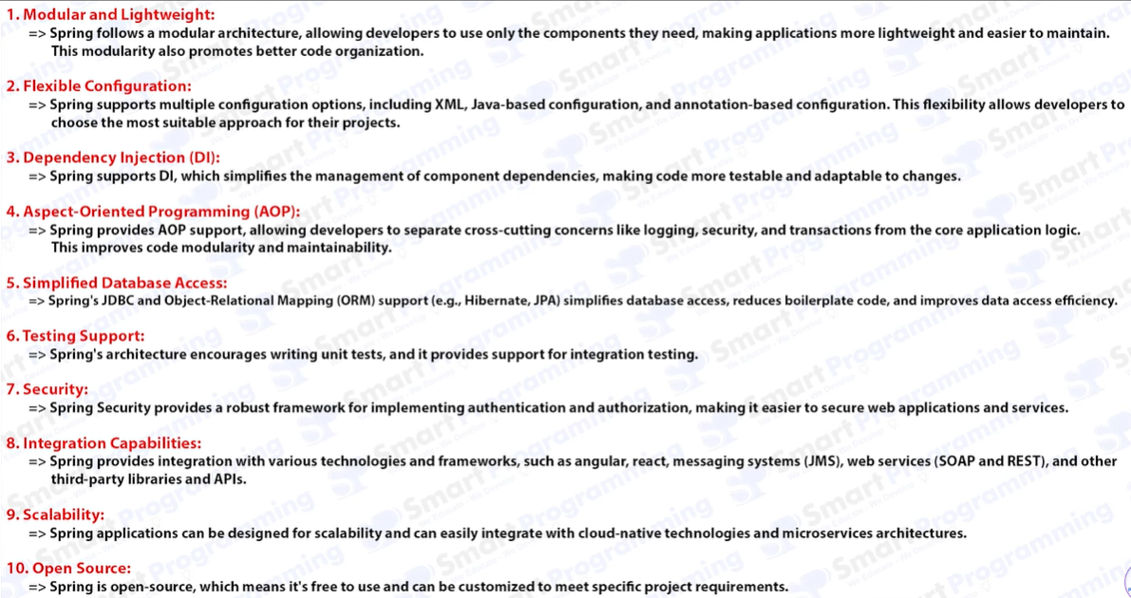
Advantages of spring framework

Slide 4
Spring IoC (Inversion of Control) container – Core or heart of Spring
What is Bean class ?
A JavaBean class should be public. This is because JavaBeans are intended to be used by other components, and they need to be able to access the class's properties and methods. If the class were not public, then other components would not be able to use it.
All properties should be private with public getters and setter methods.
Public non-argument constructor if we don’t specify also java internally creates.
Implements java.io.Serializable Interface.
The object created by Bean-Class is known as Bean-Object.
Responsibilities of spring container
It maintains the Bean object i.e object of Bean Class that is creation, initialization and assembles of Bean object.
Manages Bean Life-cycle internally.
It manages dependency injection.
Spring framework achieves AOP paradigm using Spring container.
Transaction Management, Internationalization Support can be achieved.
Integration of different frameworks.
Database Integration.

Slide 5
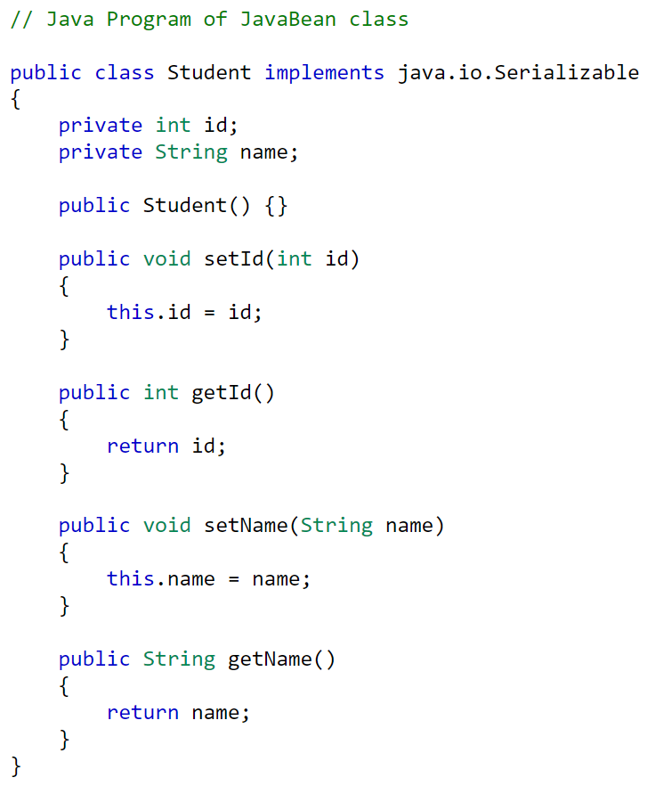
Example for Java Bean class

Slide 6
Plain Old Java Object or POJO
The POJO class increases readability & reusability of program. POJO is a regular Java object with no special restrictions.
The methods and properties of POJO do not need to follow any naming conventions.
Following are some important properties of the POJO class in java :
The POJO class in java should always be public.
It should always have a public default constructor. (It does not necessarily need to have a no-arg constructor.)
It may contain the arguments constructor.
The POJO class fields can be public, private, or protected.
The POJO class in java must not extend predefined classes.
The POJO class in java must not implement prespecified or predefined interfaces.
The POJO class in java must not have any prespecified annotation.

Slide 7
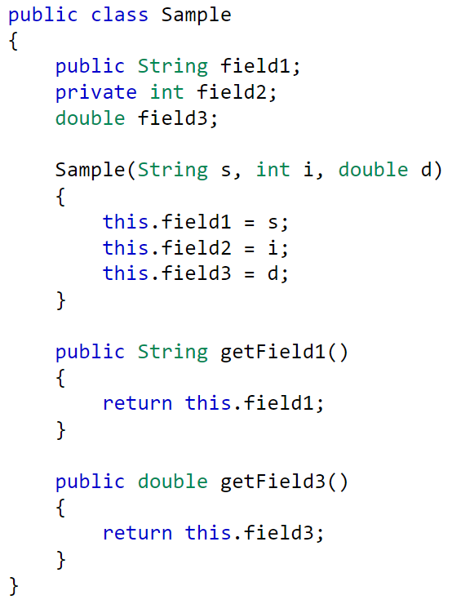
An example of POJO is shown in the Sample class. It contains three properties. These properties do not follow any particular access rule. Field1 is public, whereas field2 is private. No fixed convention is used to define the setters and getters. Field1 and Field3 have getters, but no setters are used in the class.

Slide 8
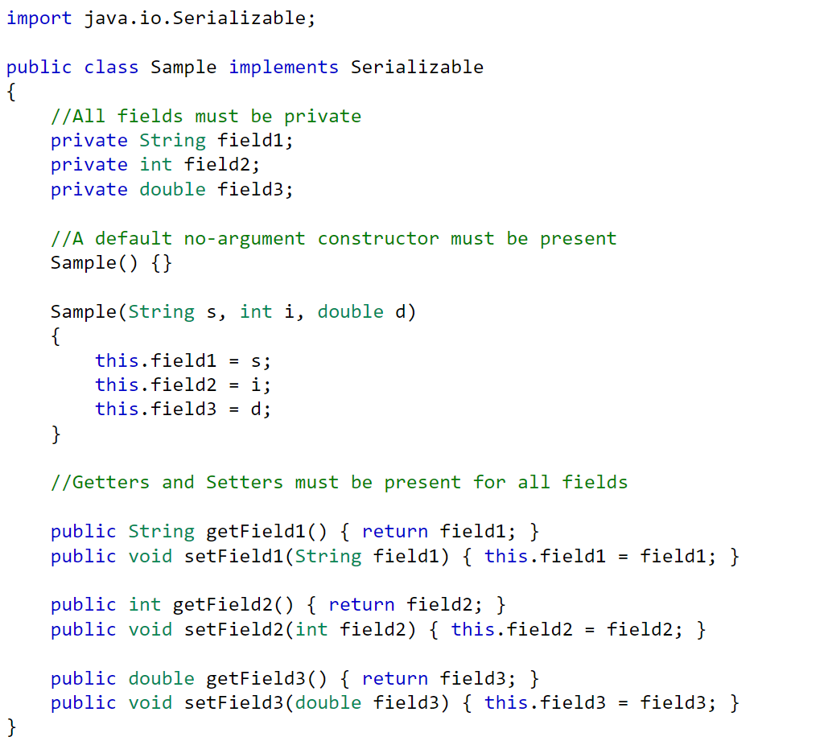
Converting POJO class into Java Bean

Slide 9
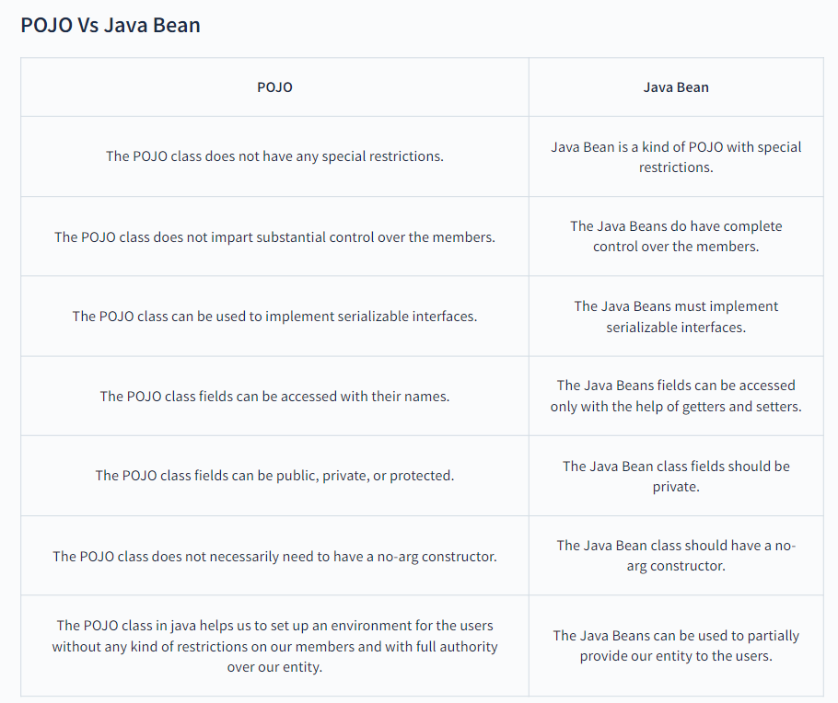

Slide 10
2 Types of spring IOC container
To invoke or start spring container we can use any of below two :
BeanFactory Interface 🡪 Very old we don’t use nowadays, Reason : BeanFactory does not support Annotation-based configuration whereas ApplicationContext does.
ApplicationContext Interface 🡪 Mostly used. ApplicationContext extends the features of BeanFactory. The ApplicationContext interface is built on top of the BeanFactory interface. It adds some extra functionality than BeanFactory such as simple integration with Spring's AOP, Message resource handling, Event propagation, Application layer specific-context (eg : WebApplicationContext) for web Applications.
Note : Follow reverse order naming for package.
Package names are written in all lower case to avoid conflict with the names of classes or interfaces.
For eg our website : www.geeksforgeeks.com
Client : ICICI bank
Loan 🡪 Home Loan, Car Loan, Education Loan.
Package 1 : in.geeksforgeeks.icici.loan.home loan
Package 2 : in.geeksforgeeks.icici.loan.car loan

Slide 11
Working of Spring Container
Step 1 : We will be creating as many POJO or Bean class we want.
Step2 : Use any configuration file to provide instruction to the spring container such as xml, java or annotations in which we give which class’s object should be created, what should be the id of the object, name of the object and what properties should be set inside that object.
Step 3 : Spring container read POJO class and Configuration file and creates multiple object inside the container.
Step 4 : Access the objects of the container.
POJO or Bean classes
Access objects
Configuration file
XML file
Java File
Annotations
Spring Container

Slide 12
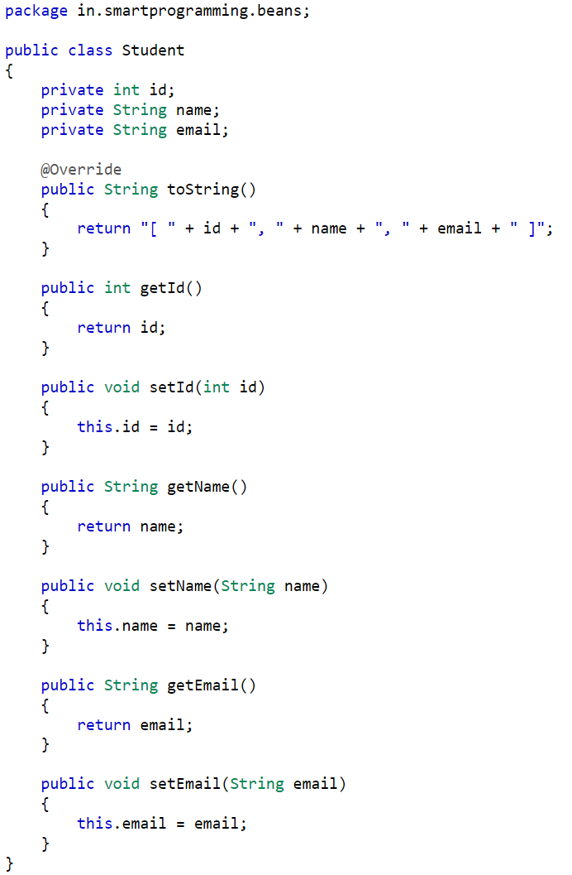
POJO class 🡪 Student.java

Slide 13
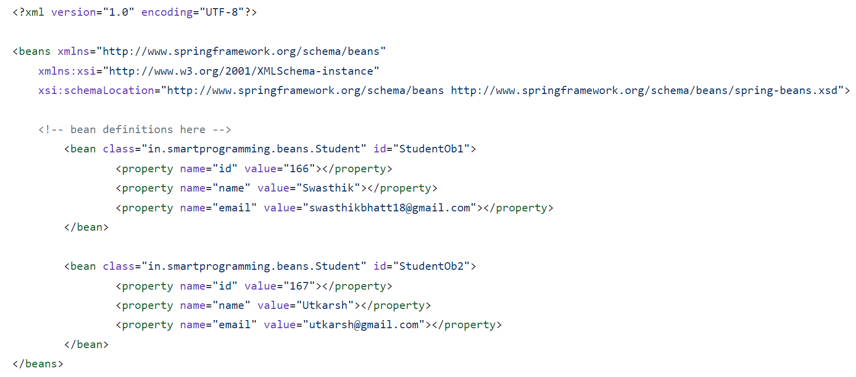
Xml configuration file 🡪 ApplicationContext.xml

Slide 14
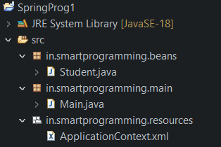
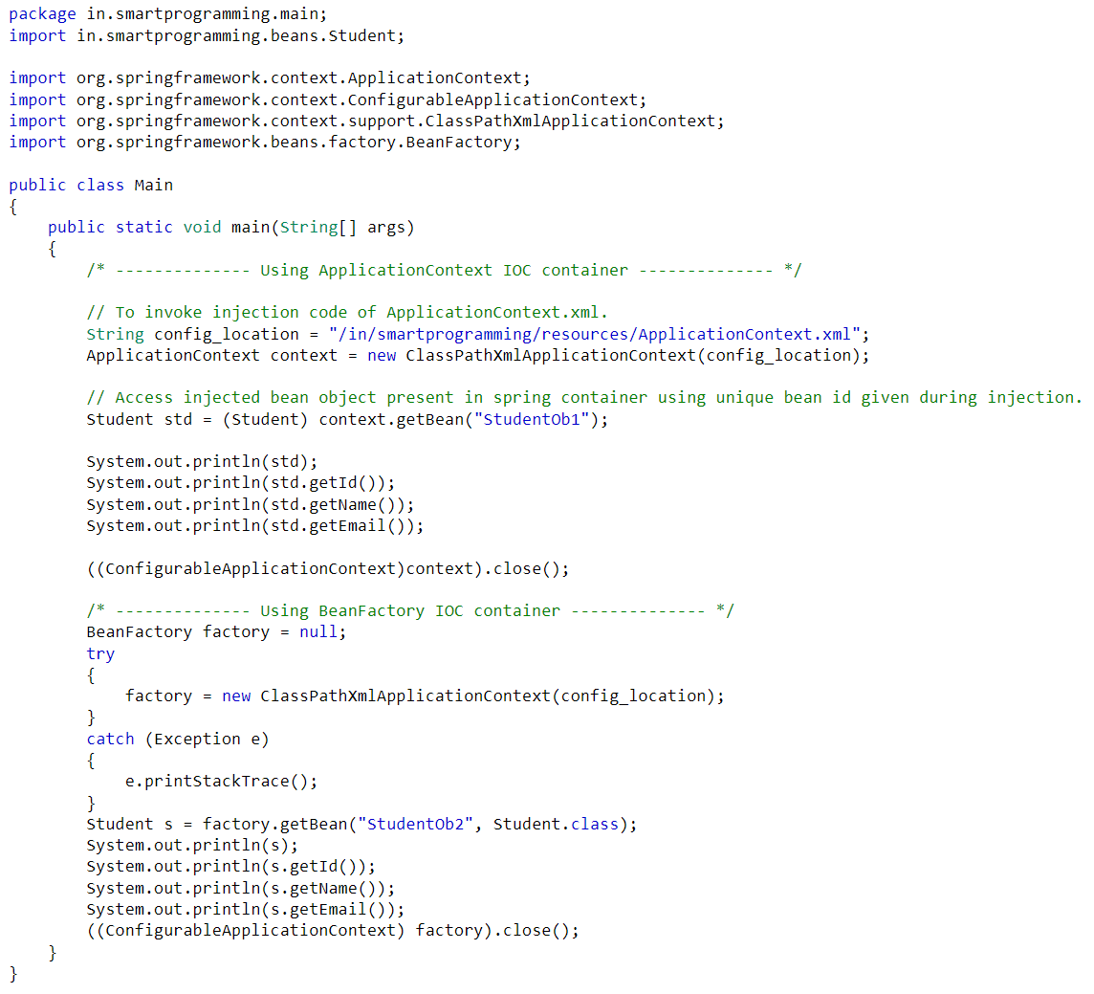
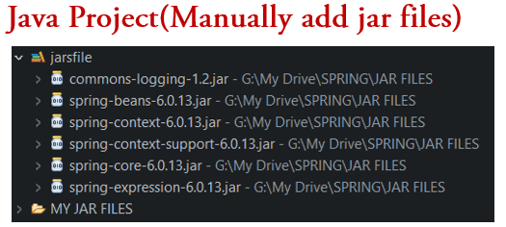
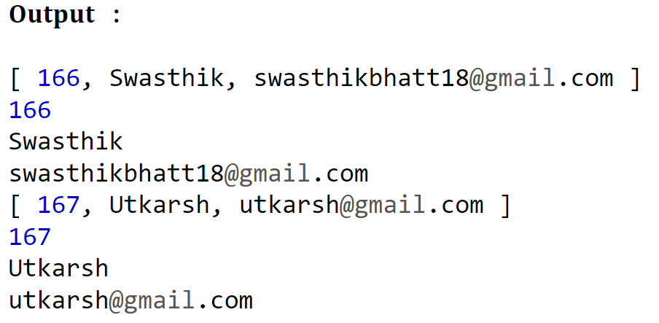
Main class 🡪 Main.java

Slide 15
What is Bean ?
In Spring, the objects that form the backbone of your application and that are managed by the Spring IoC container are called beans. A bean is an object that is instantiated, assembled, and otherwise managed by a Spring IoC container.
Spring @Configuration Annotation
@Configuration annotation indicates that the specified class is spring configuration class.
@Configuration annotation indicates that the class has @Bean definition methods and configuration settings. So Spring container can process the class and generate Spring Beans to be used in the application. This annotation is part of the spring core framework.
Spring @Bean Annotation
One of the most important annotations in spring is the @Bean annotation which is applied on a method to specify that it returns a bean to be managed by Spring context. Spring Bean annotation is usually declared in Configuration classes methods. This annotation is also a part of the spring core framework.
In XML configuration we provide an “id” attribute to specify the Bean name, but in Java configuration the method name itself become the default Bean name.
In XML configuration we provide an “class” attribute to specify the Bean object type, but in Java configuration the return-type specifies the Bean object type.
In XML configuration we have used ClassPathXmlApplicationContext, but in Java configuration we use AnnotationConfigApplicationContext.

Slide 16
@Primary annotation
In xml : <bean primary="true/false"/>
When there are multiple beans available of same type in Spring container, all of them are qualified to be autowired to single-valued dependency. That causes ambiguity and leads to throw an exception by framework. @Primary indicates that a bean should be given preference when multiple candidates are qualified to autowire a single-valued dependency.
There should be only one @Primary bean among same type of beans.
@Component Annotation
@Component is a class-level annotation. It is used to denote a class as a Component. It automatically creates the bean object having name same as class name but first letter is small letter unlike class and with all properties having their default or null values. We just have to specify add <context:component-scan base-package = “”> in xml to instruct the spring framework to perform component scanning.
It scans specified package i.e base package component in the application's classpath for classes annotated with annotations like @Component, @Service, @Repository, @Controller. These discovered classes are then registered act spring beans and enabling automatic dependency injection and other spring features.
If we are java configuration then add for component scanning : @ComponentScan(“your package")
If we have multiple packages use arrays : @ComponentScan({"pack1", "pack 2", "pack 3"})
Another way is : @ComponentScan(basePackages = {"pack1", "pack 2", "pack3"})
Note : Don’t forget to use context based xml template while dealing with @component.

Slide 17
Spring provides special annotations called Stereotype annotations which will help to create the Spring beans automatically in the application context. The stereotype annotations in spring are @Component, @Service, @Repository and @Controller.
Spring framework provides three other specific annotations to be used when marking a class as a Component. These are all mainly used in spring MVC.
@Service : This Annotation specify that the class with @Service holds some business logic or services in it. Besides being used in the service layer, there isn’t any other special use for this annotation.
@Repository : This Annotation specifies that the class with @Repository is dealing with CRUD Operations( Create Read Update Delete). It mostly deals with DAO or with Repositories that deal with databases.
@Controller : This Annotation specifies that the class with @Controller to indicate that they’re front controllers and responsible to handle user requests and for returning the appropriate responses to user. It is mostly used with REST Web Services.
Spring @Value Annotation
@Value annotation which is used to inject default values to variables and method arguments implicitly and explicitly. We can read spring environment variables as well as system variables using @Value annotation. It also supports Spring Expression Language (SpEL).
How to import one file into another ?
In xml configuration : <import resource="classpath:/com/infosys/resources/config.xml"/>
In Java configuration : @ImportResource("classpath:app-config.xml")

Slide 18
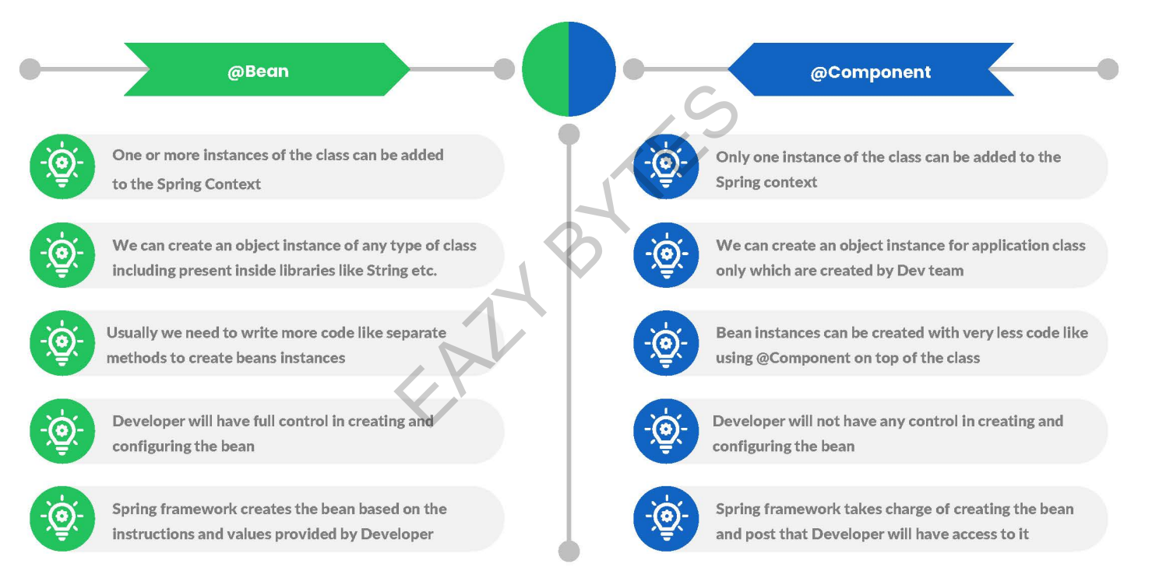

Slide 19
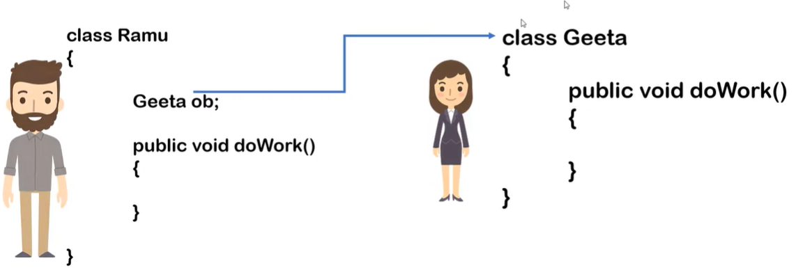
Dependency injection
It is a design pattern that removes the dependency from the programming code so that it can be easy to manage & test.
Ramu and Geeta are 2 classes, Ramu depends on Geeta to complete a work i.e Ramu needs a Geeta class object. In such a situation the class Ramu is called the "dependant" and the class or interface Geeta is called the "dependency".
Before in core Java, Servlet & JSP we used to create a Geeta object using new keyword or using factory method i.e using getter method which makes application tightly coupled. If resource is changed, we need to perform a lot of modification in the code. In future if we change anything in Geetha class then we have to recompile Ramu class also. This approach creates a lot of problems while testing the application especially in black box testing.
In spring, spring only creates object of Geeta class and inject making application loosely coupled and testing friendly.

Slide 20
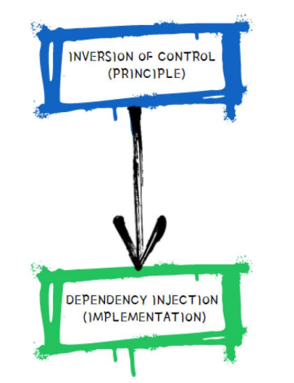
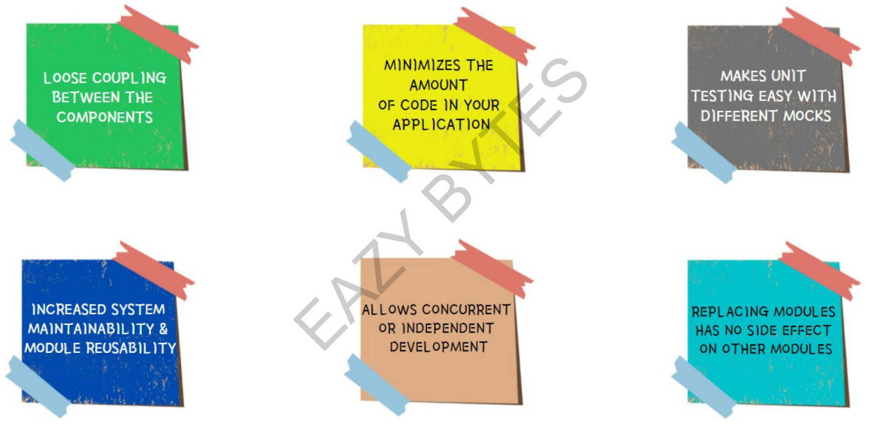
Inversion of control
So we gave our control of creation of object to spring, So that spring at runtime inject all dependencies. This process is called as Inversion of control.
Spring IoC (Inversion of Control) gets the information about the objects from a configuration file(XML) or Java Code or Java Annotations and Java POJO class. These objects are called Beans. Since the Controlling of Java objects and their lifecycle is not done by the developers, hence the name Inversion Of Control.
IOC is the principle, where the control flow of a program is inverted : instead of the programmer controlling the flow of a program, the framework or service takes control of the program flow.
Dependency Injection is the pattern through which Inversion of Control achieved.
Through Dependency Injection, the responsibility of creating objects is shifted from the application to the Spring IOC container. It reduces coupling between multiple objects as it is dynamically injected by the framework.

Slide 21
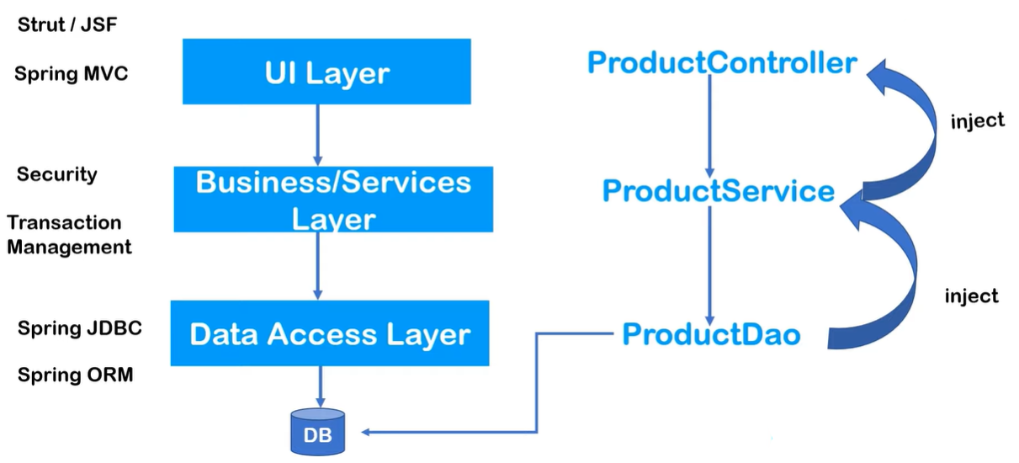
Advanced Java Web application architecture
UI layer : contains java classes, This layer handle requests.
ProductController is a simple java class which accepts requests. It uses logic of ProductService.
In ProductService is also a java class which contains all the business logic.
ProductDao is a java class that can access the database & pass data to ProductService which passes to ProductController.

Slide 22
Spring Core Modules
Test
Spring test module provides the supports for testing of spring components with JUnit or TestNG frameworks.
Core Container
Spring Core Module : The spring core module of the spring framework is the core module of the spring framework. This module is responsible for the implementation of features like IoC (inversion of control) and dependency injection with a singleton pattern.
Spring Bean Module : This Module is responsible for providing the implementation of the factory design pattern through the Bean factory.
Spring Context : This module is a medium for accessing any object defined and configured. This module has been built on the base provided by the core module and Bean module.
Expression language : change and query object graph i.e values at runtime.
Data Access/Integration
JDBC : JDBC modules provides a JDBC-abstraction layer.
ORM : ORM provides integration layers for object-relational mapping APIs like JPA, and Hibernate etc.
OXM (Object XML Mapping) : OXM module provides an abstraction layer for Object/XML mapping APIs like JAXB, Castor and XML Beans etc.
JMS (Java Message Service) : JMS module provides feature of message processing.
Transaction : Transaction module provides the facility of transaction management for classes like POJOs etc.

Slide 23
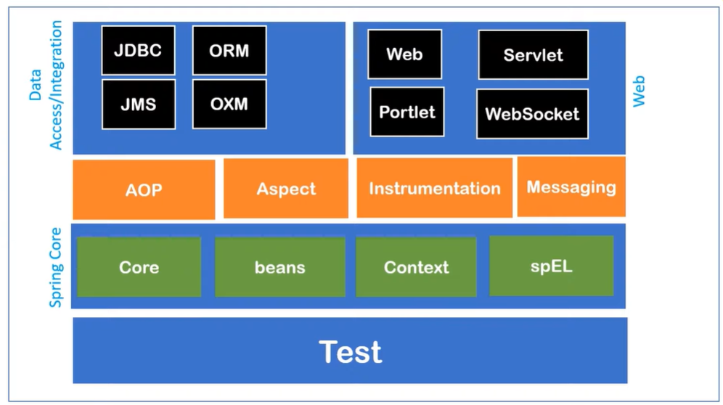
Web and remoting Module
This module is for distributed application development using the spring framework. Spring web allows spring developers to integrate Struts with Spring framework or it allows the developer to write MVC application also with Spring framework. Spring remoting tells about how to invoke the services of other beans which are running at some other JVM across the network.
Web : The web module is using the Servlet listeners and a web-oriented application context.
Web Servlet : This module contains MVC-based implementation for web Apps.
Web Portlet : This module of the spring framework is also called as Spring-MVC-Portlet which is responsible for providing the support for spring-based portlets.

Slide 24
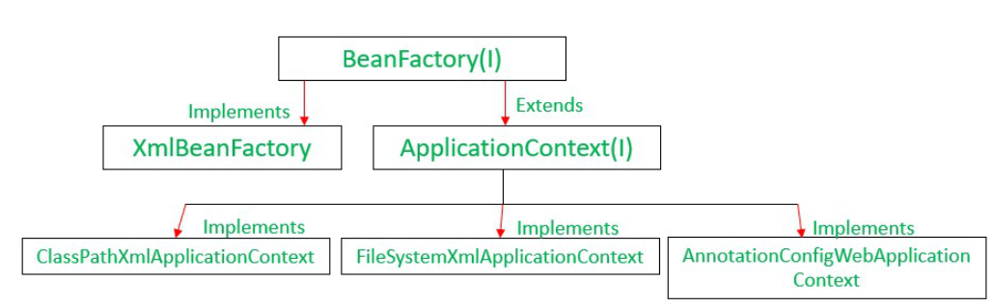
ApplicationContext Types
ApplicationContext context = new ClassPathXmlApplicationContext("bean.xml");
loads context definition from an XML file located in the classpath, treating context definitions as classpath resources.
ApplicationContext context = new FileSystemXmlApplicationContext("bean.xml");
loads context definition from an XML file in the filesystem.
ApplicationContext context = new XmlWebApplicationContext();
loads context definition from an XML file contained within a web application.
ApplicationContext context = new AnnotationConfigApplicationContext ();
Searches beans on which annotation is applied.

Slide 25
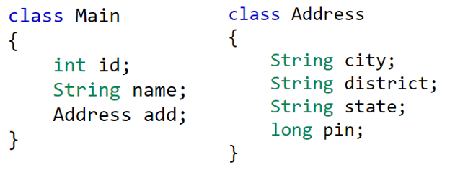
2 ways to inject dependency
By Constructor
By Setter or property method
Spring container inject id and name object at runtime to Student object.
Also IOC container inject Address object having all values assigned to Student object at runtime.
Data-Type handled by IOC containers
Primitive type : int, boolean, long, etc.
Collection type : Set, Map, Properties, List.
Reference type or User defined type : one object injection into another class object.
Configuration Metadata
The spring IOC container consumes a form of configuration metadata this configuration metadata represents how you as an application developer tell the spring container to instantiate, configure and assemble the objects in your application.

Slide 26
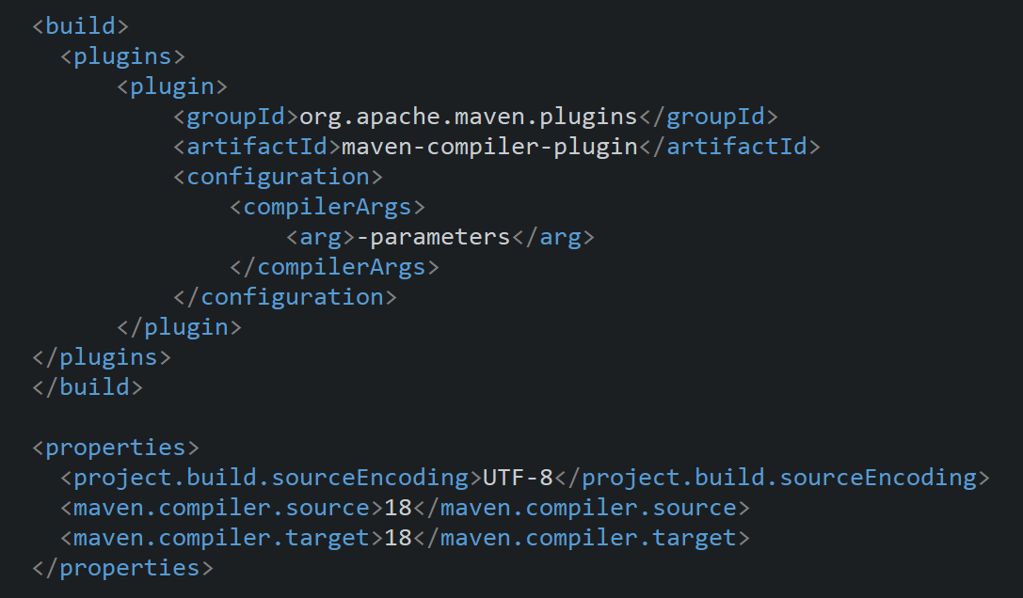
Warning Message Solution in SprinProg5 in pom.xml 🡪 Not harmful
org.springframework.core.LocalVariableTableParameterNameDiscoverer inspectClass.
WARNING: Using deprecated '-debug' fallback for parameter name resolution. Compile the affected code with '-parameters' instead or avoid its introspection:
Add marked code in pom.xml :

Slide 27
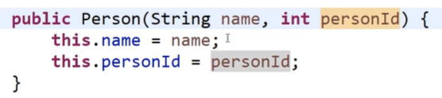
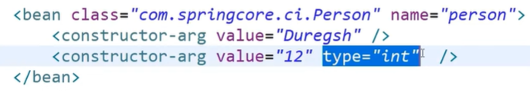
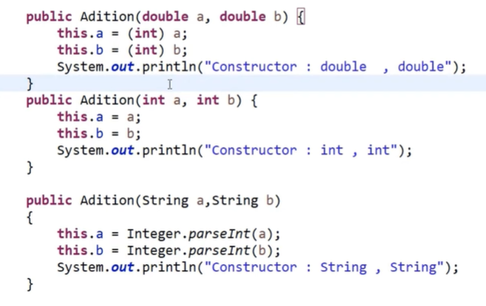
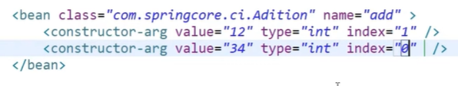
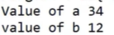
Ambiguity in Constructor injection resolution using type attribute
Here in case 1 we don’t need to specify the type attribute bcoz constructor automatically understands that value is int since we have a single constructor. But we will get error if we have more than 1 constructor, in such case use type attribute.
If we had add(String, string) constructor 🡪 Then will be called.
If we did not have add(String, string) constructor 🡪 Then top most constructor will be called.
index attribute : It specifies which value should go to which constructor argument, argument array starts from 0.

Slide 28
Spring Bean Life Cycle
Bean life cycle is managed by the spring container.
When we run the program then, first of all, the spring container gets started.
After that, the IoC container creates the instance of a bean as per the request with default values i.e bean instantiation using no- argument or default constructor, and then dependencies or properties are injected i.e bean initialization using java config, xml based property tags or annotations i.e using the dependency injection.
The bean factory container calls setBeanName() which take the bean ID and the corresponding bean has to implement BeanNameAware interface.
The factory then calls setBeanFactory() by passing an instance of itself (if BeanFactoryAware interface is implemented in the bean).
If BeanPostProcessors is associated with a bean, then the preProcessBeforeInitialization() methods are invoked.
If we want to execute some code on the bean instantiation we can write that code inside the custom init() method.
Lastly, postProcessAfterInitialization() methods will be called if there are any BeanPostProcessors associated with the bean that needs to be run post creation.
Just before closing the spring container, then and the destroy() method.
And finally, the bean is destroyed when the spring container is closed.
Note : Implementing bean cycle using interfaces | IntializingBean 🡪 afterPropertiesSet() | DisposableBean 🡪 destroy()
Note : Implementing Bean life cycle using Annotations | @PostConstruct | @PreDestroy, add extra dependency to use this.

Slide 29
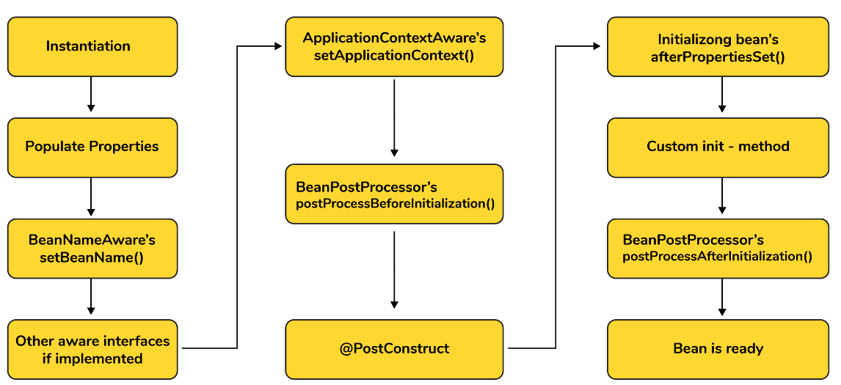
Spring provides 2 methods to every bean :
public void init() 🡪 Object get created and then properties will get set and then init() method will get called. Loading any services and configuration file or sockets, and connecting to database.
public void destroy() 🡪 Any clean up code before destroying any bean object. The destroy() method will be called before the bean is removed from the container. destroy-method is bean attribute using which we can assign a custom bean method that will be called just before the bean is destroyed. <bean id="student" class="com.infosys.Student" destroy-method="myPreDestroy">

Slide 30
What are the bean scopes available in Spring ?
The Spring Framework has five scope supports. They are :
Singleton (By default) : The scope of bean definition while using this would be a single instance per IoC container. Creates only 1 object, in future it gives a reference of the object whenever you call, if you check hashCode it will be same.
Prototype : Here, the scope for a single bean definition can be any number of object instances.
Request used for web application : The scope of the bean definition is an HTTP request.
Session used for web application : Here, the scope of the bean definition is HTTP-session.
Global-session : The scope of the bean definition here is a Global HTTP session.
Note : The last three scopes are available only if the users use web-aware ApplicationContext containers.

Slide 31
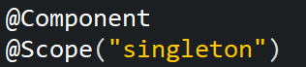
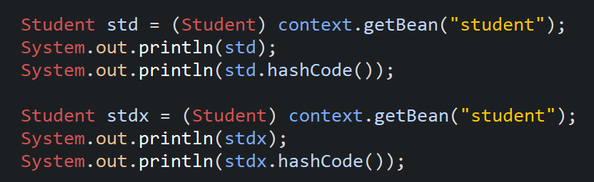
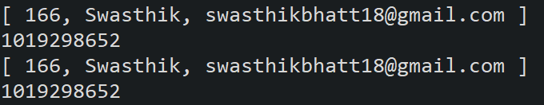
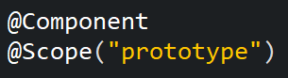
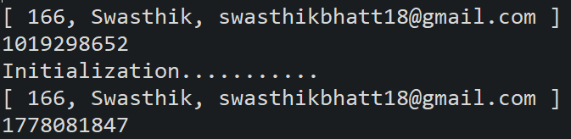
Singleton scope :
Prototype scope :

Slide 32
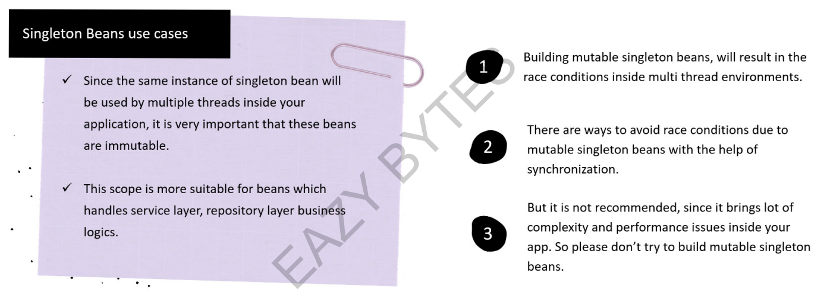

Slide 33
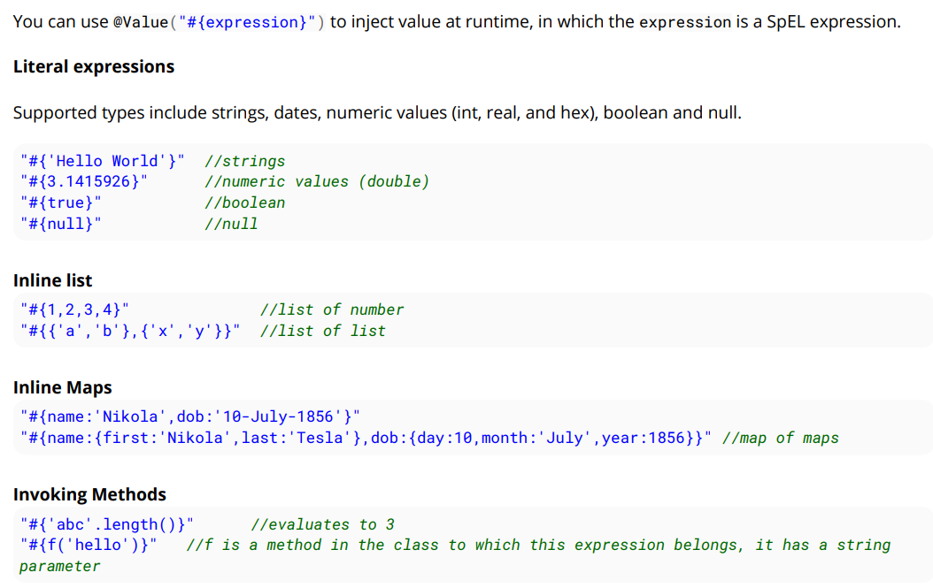
Spring Expression Language (SpEL)

Slide 34
What is autowiring and name the different modes of it ?
We used to manually inject dependency to particular class object before using manual wiring, but here the IoC container is very smart since it autowires relationships between the application beans. Spring lets collaborators resolve which bean has to be wired automatically by inspecting the contents of the BeanFactory.
Using @Autowired, the right dependency is assigned by the Spring Container.
Different modes of this process are :
no : This means no autowiring and is the default setting. An explicit bean reference should be used for wiring.
byName : The bean dependency is injected according to the name of the bean. This matches and wires its properties with the beans defined by the same names as per the configuration.
byType : This injects the bean dependency based on type.
constructor : Here, it injects the bean dependency by calling the constructor of the class. It has a large number of parameters.
autodetect : First the container tries to wire using autowire by the constructor, if it isn't possible then it tries to autowire by byType. It is deprecated now we can’t use it.
What are the limitations of autowiring ?
Overriding possibility : Dependencies are specified using <constructor-arg> and <property> settings that override autowiring.
Data types restriction : Autowiring can’t used to inject Primitive data types and Strings. It works with objects or reference types only.

Slide 35
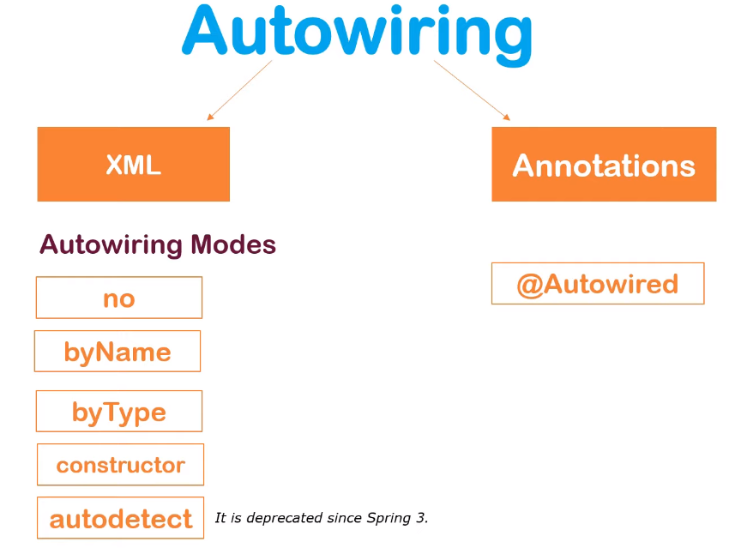

Slide 36
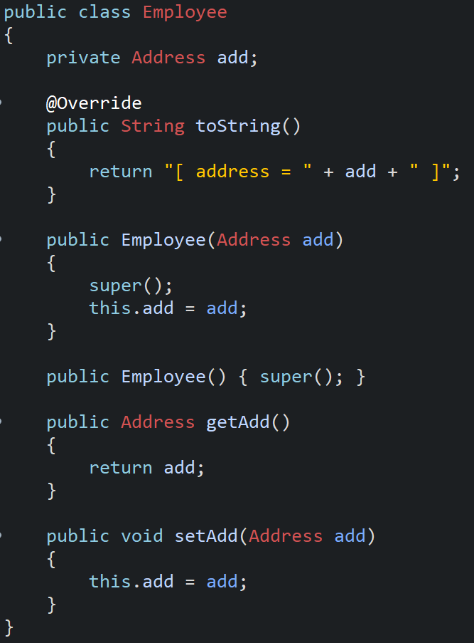
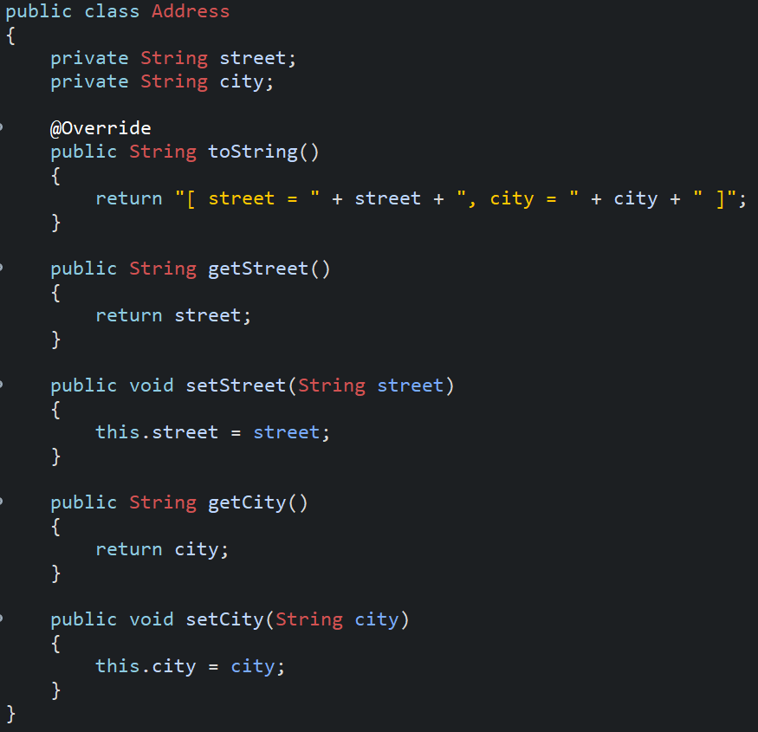

Slide 37
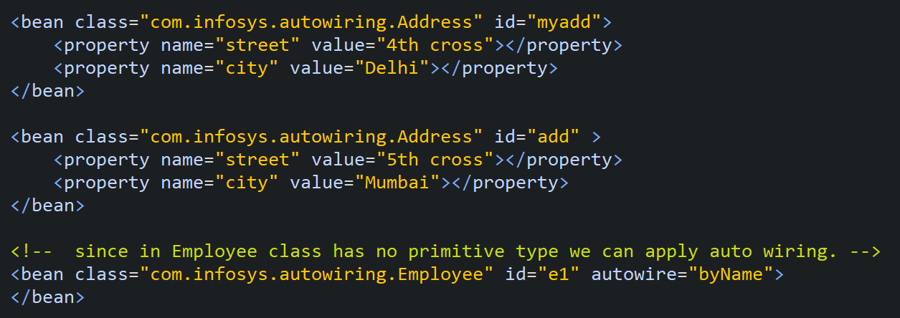
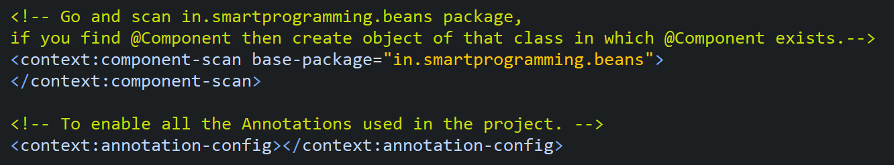
While using autowire="byName" the id in xml and the variable name in POJO class file should be same.
Note : ByName and ByType use setter injection, while constructor use constructor injection.

Slide 38
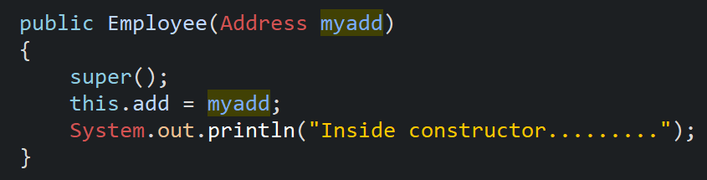
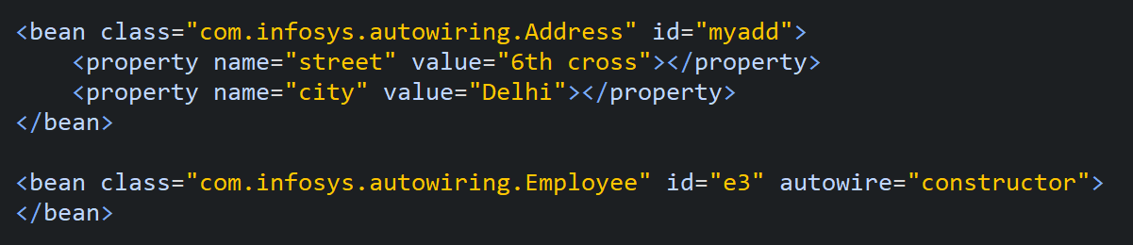
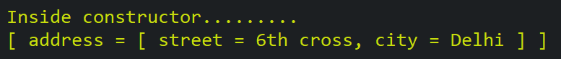
While using autowire=“constructor" the id in xml and the constructor argument in POJO class file should be same.
Difference between @Component and @Autowired ?
So in simple terms @Component annotation is to make Spring Framework aware of a class and @Autowired is to get the instance of that class actually.

Slide 39
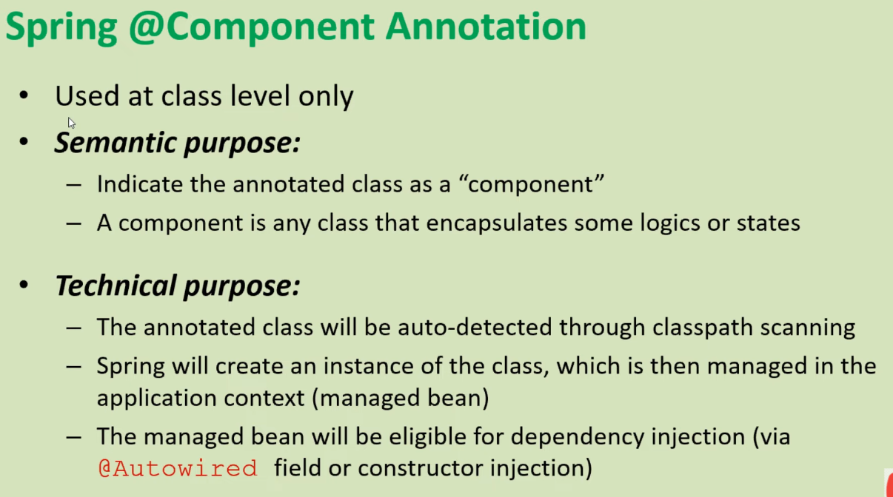
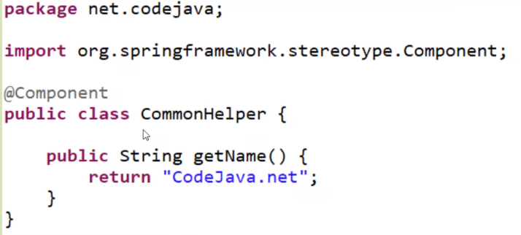
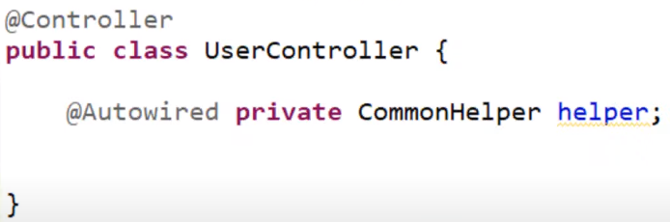

Slide 40
@Qualifier annotation
@Autowired follows byType mode if byType fails it goes for byName, so if both fails i.e we have multiple ref beans we will get error to resolve this we use @qualifier.
One of the most important annotations in spring is @Qualifier annotation which is used to eliminate the issue of which bean needs to be injected.
Conclusion : Spring @Autowired Annotation first looks for “byType” if there is any conflict then it is going to look for “byName”. And if any conflict with “byName”, resolve that with @Qualifier Annotation.
Note : Following are the use case which i have tried and came into the conclusion :
Use case 1 : if property , setter method & constructor all are @Autowired at the same time , then setter method @Autowired takes the more precedence.
Use case 2 : Even though @Qualifer is used in property and constructor then also setter method @Autowired and @Qualifier will take more precedence
Use case 3 : If property and constructor are annotated simultaneously with @Autowired and @Qualifier then property will take more precedence.

Slide 41
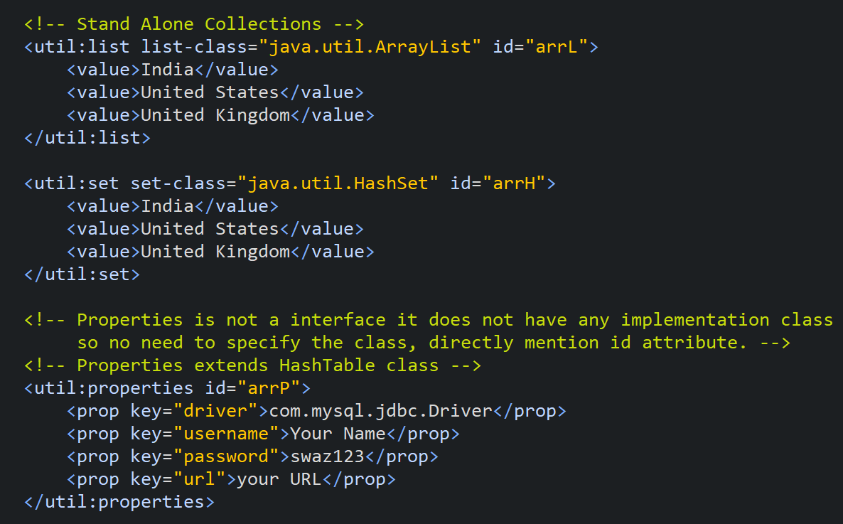
Spring Standalone Collections[List, Map, Properties] | Util Schema in Spring
Don’t forget to add this in xml to use stand-alone collections :
xmlns:util="http://www.springframework.org/schema/util"
xsi:schemaLocation = “http://www.springframework.org/schema/util
http://www.springframework.org/schema/util/spring-util.xsd”
Note : Spring framework internally uses LinkedHashMap as the default implementation for the util:map bean. When you define a util:map bean, the Spring internally creates a LinkedHashMap to store the key-value pairs

Slide 42
@Repository 🡪 Used in Persistence layer(Data Access Layer).
@Repository is a Spring annotation that is used to indicate that a class is a data repository and should be managed by the Spring framework. It’s used to indicate that a class is a data access object (DAO) and can be used to catch and translate data access exceptions. The @Repository annotation is used to mark a class as a data repository and make it eligible for dependency injection. This allows the class to be easily reused and tested.
A repository class is typically used in the data access layer of the application and it’s responsible for interacting with a data source, such as a database, to retrieve and persist data. Repository classes provide a consistent, well-defined API for the rest of the application to use when working with data.
A repository class typically contains methods that perform CRUD (create, read, update, delete) operations on the data source and these methods can be called by other components of the application such as controllers, services, and other repository classes.
It’s also important to note that @Repository classes are typically used in conjunction with other Spring annotations such as @Autowired, @Transactional, and @Query to handle transactions, and to perform complex queries on the data source.
Note : Technically @Controller, @Service, @Repository are all same. All of them extends @Component. Thus, it’s not wrong to say that @Controller, @Service and @Repository are special types of @Component annotation. <context:component-scan> picks them up and registers their following classes as beans, just as if they were annotated with @Component.

Slide 43
@Service 🡪 Used in business layer.
@Service beans hold the business logic and call methods in the repository layer.
What’s special about @Service ?
Apart from the fact that it's used to indicate, that it's holding the business logic, there’s nothing else noticeable in this annotation; but who knows, Spring may add some additional exceptional in future.
@Controller 🡪 used in the presentation layer.
The @Controller annotation indicates that a particular class serves the role of a controller. The @Controller annotation acts as a stereotype for the annotated class, indicating its role.
What’s special about @Controller ?
We cannot switch this annotation with any other like @Service or @Repository, even though they look same. The dispatcher scans the classes annotated with @Controller and detects methods annotated with @RequestMapping annotations within them. We can use @RequestMapping on/in only those methods whose classes are annotated with @Controller and it will NOT work with @Component, @Service, @Repository etc...

Slide 44
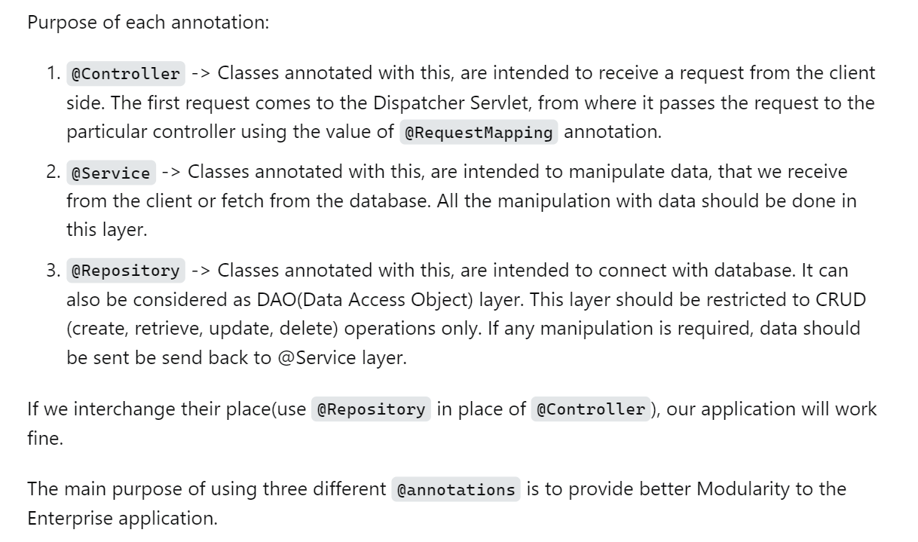

Slide 45
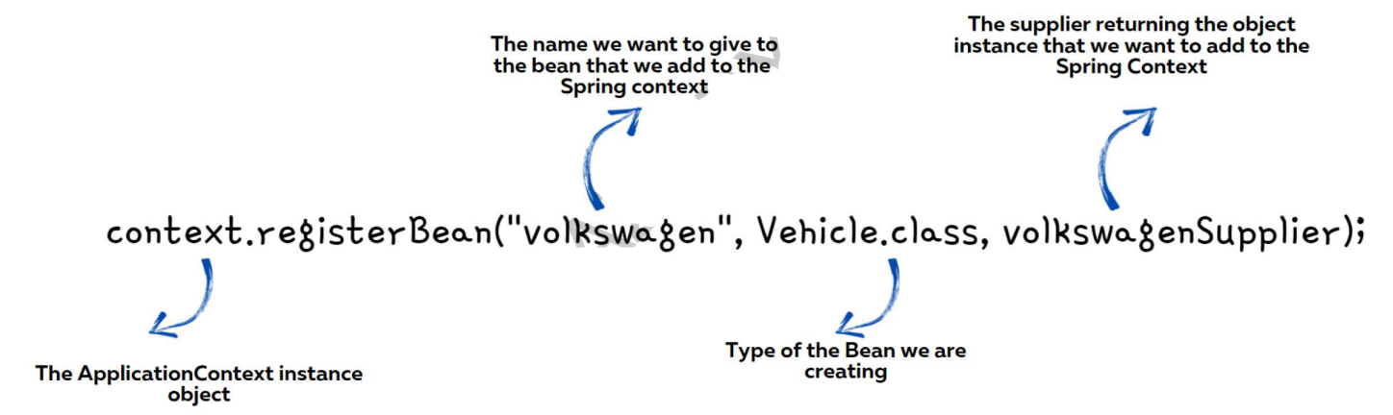
Adding new Beans Programmatically
Sometimes we want to create new instances of an object and add them into the Spring context based on a role condition. For the same from spring 5 version, a new approach is provided to create the beans programmatically by invoking the method registerBean() present inside the context object.

Slide 46
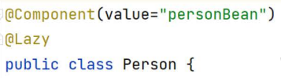
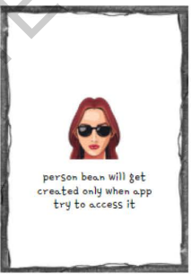
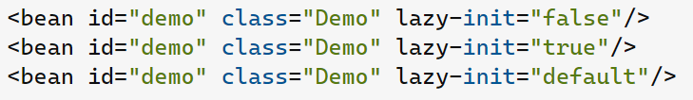



Eager and Lazy initialization using @lazy Annotation 🡪 Refer SpringProg3
By default spring will create all the Singleton Beans eagerly during the startup of the application itself. This is called Eager initialization.
We can change the default behavior to initialize the singleton beans Lazily only when the application is trying to refer to the bean. This approach is called lazy initialization. This speed ups the execution process.
When we use lazy-init="default" as an attribute in element, the container picks up the value specified by default-lazy-init="true | false" attribute of element and uses it as lazy-init="true | false".
If default-lazy-init attribute is not present in element than lazy-init="default" in element will behave as if lazy-init-"false".
Sample demo for lazy initialization :

Slide 47


Slide 48
Spring JDBC
Internally Spring JDBC uses java JDBC only but it has extra features.
JDBC is an API to perform operations with databases.
Problems of Java JDBC ?
We need to write lot of code, every time we have open and close connection.
Every time we had to handle checked exception i.e SQLException using try-catch. In spring JDBC all exceptions are un-checked exception.
Solution : Spring JDBC overcomes all these problems.
Spring JDBC has a class called JdbcTemplate which has all the methods to deal with database and fire all the queries.
DataSource is an interface, it has all information like URL, password, username to connect with database. We have a implementation class of DataSource DriverManagerDataSource.
Selecting data using Spring Jdbc
RowMapper is a interface converts result set into object.

Slide 49


Slide 50


MySQL database setup 🡪 SpringProg7
create database SpringProg7;
show databases;
use SpringProg7;
create table student(id int primary key, name varchar(100) not null, city varchar(100));
show tables;
insert into student(id, name, city) values(166, "Swasthik", 'Udupi');
insert into student(id, name, city) values(167, "Utkarsh", 'Patna’);

Slide 51

Postgre SQL database setup 🡪 SpringProg7
create database SpringProg7;
select datname from pg_database where datistemplate = 'false';
\c SpringProg7; 🡪 In psql, no need to switch to database in pgadmin.
create table student(id int primary key, name varchar(100) not null, city varchar(100));
select * from pg_catalog.pg_tables
where schemaname = 'public' and schemaname != ‘information_schema’
insert into student(id, name, city) values(166, 'Swasthik', 'Udupi');
insert into student(id, name, city) values(167, 'Utkarsh', 'Patna');
select * from student;

Slide 52


Database set-up for different Databases
MySQL
Postgre SQL

Slide 53
Adding security in each Layer of architecture
What is a Concern ?
The concern is behavior that we want to have in a particular module of an application. A concern may be defined as a functionality we want to implement.
Types of concerns ?
Core Concerns : The concerns representing single and specific functionality for primary requirements are known as core concerns. OR Primary functionality of the system is known as core concerns.
For example : Business logic
Crosscutting concerns : In any application, there is some generic common functionality that is needed in many places. But this functionality is not related to the application's business logic.
The concerns representing functionalities for secondary requirements are referred to as crosscutting concerns or system-wide concerns. OR The crosscutting concern is a concern which is applicable throughout the application and it affects the entire application.
For example : logging, security, Transaction management, Performance monitoring, Error handling, Caching, Custom business rules and data transfer are the concerns which are needed in almost every module of an application, hence they are cross-cutting concerns.
AOP increases modularity by allowing the separation of cross cutting concerns.
Note : Make common functionalities as Aspect and you can configure it and use it in Every module.

Slide 54
Aspect
The class that handles code to intercept method calls in a specified class. Use @Aspect on class level.
Basically class contains code which has to be called by main class containing business logic or core concerns.
The class which implements the JEE application cross-cutting concerns(transaction, logger etc) is known as the aspect. It can be normal class configured through XML configuration or through regular classes annotated with @Aspect.
JoinPoint
A joinpoint is a candidate point in the Program Execution of the application where an aspect can be plugged in. This point could be a method being called, an exception being thrown, or even a field being modified. These are the points where your aspect’s code can be inserted into the normal flow of your application to add new behavior.
Note : Spring only supports method execution join point. So method is a joinpoint.
Advice
This is a action (basically method) present in the Aspect class which has to be performed at a joinpoint.
Pointcut
A pointcut defines at what joinpoints, the associated Advice should be applied. Advice can be applied at any joinpoint supported by the AOP framework. Of course, you don’t want to apply all of your aspects at all of the possible joinpoints. Pointcuts allow you to specify where you want your advice to be applied.
Often you specify these pointcuts using explicit class and method names or through regular expressions that define matching class and method name patterns. Some AOP frameworks allow you to create dynamic pointcuts that determine whether to apply advice based on runtime decisions, such as the value of method parameters.

Slide 55




So basically PointCuts are the subset of JoinPoints. Once you start using these quite a bit, you might end up specifying many @After/@Before/@Around advices.
Weaving
The process of linking Aspects with an Advised Object. It can be done at load time, compile time or at runtime time. Spring AOP does weaving at runtime.

Slide 56

Setup for AOP
Don’t forget to add name-space in xml : xmlns:aop=http://www.springframework.org/schema/aop
To enable aop using xml configuration : <aop:aspectj-autoproxy/>
To enable aop using java configuration : @EnableAspectJAutoProxy

Slide 57


Types of @Advice

Slide 58


Slide 59
Spring Framework with ORM Frameworks like Hibernate, TopLink, iBATIS
Spring-ORM is a technique or a Design Pattern used to access a relational database from an object-oriented language. ORM (Object Relation Mapping) covers many persistence technologies. They are as follows :
JPA(Java Persistence API) now renamed to Jakarta Persistence API
It is mainly used to persist data between Java objects and relational databases. It acts as a bridge between object-oriented domain models and relational database systems.
JDO(Java Data Objects)
It is one of the standard ways to access persistent data in databases, by using plain old Java objects (POJO) to represent persistent data.
Hibernate
It is a Java framework that simplifies the development of Java applications to interact with the database.
Oracle Toplink, and iBATIS
Oracle TopLink is a mapping and persistence framework for Java development.
Why to use ORM ?
We work in different database, so we have to learn different sql language like sql, MySQL or Postgres. It’s waste of time. So ORM treats class as a table in a database and map the object of class into table of the database. ORM is a theoretical term like programming. There are many practical ORM implementational frameworks like Hibernate, Oracle Toplink, Jpox, IBATIS, ORM Lite. These framework provide their own query language, like Hibernate provides HQL (Hibernate Query Language). We don’t use native hibernate, we use hibernate with JPA.

Slide 60


In traditional hibernate approach we are mapping using xml or annotation based approach.
In modern Spring ORM, First do mapping and then if we want a object, we direct tell ORM to get the object. What ORM internally does we don’t care.
Note : Dao 🡪 Data Access Object

Slide 61

Create a object of DataSource having database properties to SessionFactory along with Hibernate Properties and Annotated class or xml.
SessionFactory is a Interafce so we can’t create a object.
There is a class which implements SessionFactory i.e LocalSessionFactoryBean, create a object of this and give it to HibernateTemplate. (Use ctrl + shift + T to see class definitions.)
And give object of HibernateTemplate to your implementation class of Dao interface i.e Dao class.

Slide 62
@Entity Annotation
Let’s start with the @Entity annotation. This annotation, part of the javax.persistence package, is used at the class level and marks the class as a persistent entity. It signals to the JPA provider that the class should be treated as a table in the database.
@Entity
public class Employee {}
In this code snippet, the Employee class is marked as an entity. This means that there will be a table in the database corresponding to this class.
However, the @Entity annotation doesn’t define the specifics about the database table. Here is where the @Table annotation comes in.
Note : The entity class must not be declared final. No methods or persistent instance variables must be declared final.
@Table Annotation
The @Table annotation provides the specifics of the corresponding database table. This includes the name of the table, the catalog, and the schema.
@Id annotation says that this field is the primary key.
@GeneratedValue(strategy = GenerationType.IDENTITY) 🡪 For auto increment primary key.
@Column annotation says that this field acts as a attribute in database table or relation.
@Column(name = "myname", unique = true, nullable = false, length = 100)

Slide 63


@Transient Hibernate Annotations in Spring Boot
jakarta.persistence.Transient 🡪Indicates that a field should not be persisted to the database.
In laymen's terms, if you use the @Transient annotation on an attribute of an entity: this attribute will be singled out and will not be saved to the database. The rest of the attributes of the object within the entity will still be saved.
I'm saving the Object to the database using the JPA repository built-in save method as so :
userRoleJoinRepository.save(user2);

Slide 64


spring.jpa.hibernate.ddl-auto = update
Create : when the server will start all entity will be newly created.
Update : when the server will start container will find which entities are update and which all are newly created the same thing will happen inside database as well old table will update as per the entity and newly table will created.
Create-drop: when the server will start then auto all entity will create and when the server will stop all the entities will auto remove from database.
none : it means database ddl will not impact from back-end application Note: Production environment always set with none value.

Slide 65
To enable write operation 🡪 use @Transaction annotation
To enable @Transaction annotation :
xmlns:tx="http://www.springframework.org/schema/tx"
xsi:schemaLocation = "http://www.springframework.org/schema/tx
http://www.springframework.org/schema/tx/spring-tx.xsd"
<!-- To enable @Transactional Annotation. -->
<tx:annotation-driven></tx:annotation-driven>
Difference between CRUD Repository and JPA Repository ?
JPA repository extends CRUD Repository. So it has all the features of CRUD Repository + It has Pagination and Sorting features.
What is EntityManager ?
EntityManager is an interface provided by Java Persistence API (JPA) specification. We can get object of EntityManager using EntityManagerFactory.
EntityManager is responsible for managing all entities like creation, deletion and transactions. Entity manager is used to read, delete and write an entity. An object referenced by an entity is managed by entity manager.
PersistanceUnit creates EntityManagerFactory objects during loading of the application.

Slide 66

Spring Boot
To access h2 database : localhost:8080/h2-console (8080 🡪 Use your port number.)

Slide 67

Types of Mapping in ORM
One-to-One Mapping
One-to-Many or Many-to-One Mapping
Many-to-Many Mapping
There are specified fetching types for each relationship type which is applied by Hibernate by default.

Slide 68



One-to-One Mapping : Create reference variable of one entity in another.
Such a relationship exists when each record of one table is related to only one record of the other table. Consider 2 entity set A and B now, every entity in a entity set A can have maximum of only 1 relationship with any entity of entity set B and also every entity in a entity set B can have maximum of only 1 relationship with any entity of entity set A.
For example,
If there are two entity sets ‘Person’ (Id, Name, Age, Address) and ‘Passport’(Passport_id, Passport_no). So, each person can have only one passport and each passport belongs to only one person.
Such a relationship is not very common. However, such a relationship is used for security purposes. In the above example, we can easily store the passport id in the ‘Person’ table only. But, we make another table for the ‘Passport’ because Passport number may be sensitive data and it should be hidden from certain users. So, by making a separate table we provide extra security that only certain database users can see it.

Slide 69


One-to-Many or Many-to-One Relationship
Such a relationship exists when each record i.e entity of one table i.e entity set can be related to one or more than one record of the other table. This relationship is the most common relationship found. A one-to-many relationship can also be said as a many-to-one relationship depending upon the way we view it.
For example,

Slide 70




Many-to-Many Relationship
Such a relationship exists when each record of the first table can be related to one or more than one record of the second table and a single record of the second table can be related to one or more than one record of the first table. A many-to-many relationship can be seen as a two one-to-many relationship which is linked by a 'linking table' or 'associate table'. The linking table links two tables by having fields which are the primary key of the other two tables. We can understand this with the following example.
For example, If there are two entity type ‘Customer’ and ‘Product’ then each customer can buy more than one product and a product can be bought by many different customers.

Slide 71




A practical example to many-to-many is the courses taken in a college. You might have a Courses table like :
Now, if you think of it, a Student can take multiple (many) Courses and a Course can have many attendant Students. That constitutes a Students(many)-to-(many)Courses relation. There is no way to directly express this without a bridge table (I am lying here but accept there is not), so you create intermediate 3rd table :

Slide 72





Slide 73







Slide 74
Primary Key Generation Strategies in Spring Boot : 1. AUTO : Automatic Incrementing
Pros : 🚀 Easy, works with many databases. Situation : ✔️ Ideal when your database supports auto-incrementing columns
@GeneratedValue(strategy = GenerationType.AUTO) 2. IDENTITY : Database-Specific Auto-Increment
Pros : ⚙️ Efficient auto-increment, optimized for specific databases. Situation : 🎯 Best for databases like MySQL, SQL Server, or PostgreSQL that support identity columns @GeneratedValue(strategy = GenerationType.IDENTITY)
3. TABLE : Using a Separate Table for IDs
Pros : 🌐 Portable, more control over key generation. Situation : 🛠️ Use when you need portability across different databases or have specific control requirements. @GeneratedValue(strategy = GenerationType.TABLE)
4. SEQUENCE : Efficient for Databases with Sequences
Pros : 📈 Optimized for databases supporting sequences. Situation : 🏹 Ideal for databases like Oracle with native support for sequences.
@Id @GeneratedValue(strategy = GenerationType.SEQUENCE, generator = "mySeqGen") @SequenceGenerator(name = "mySeqGen", sequenceName = "my_sequence") private Long id;

Slide 75
What is the difference between @ManyToOne(optional=false) vs. @Column(nullable=false) : SpringProg16
Answer 1 :
@Column(nullable=false) is an instruction for generating the schema. The database column generated off the class will be marked not nullable in the actual database.
optional=false is a runtime instruction. The primary functional thing it does is related to Lazy Loading. You can't lazy load a non-collection mapped entity unless you remember to set optional=false (because Hibernate doesn't know if there should be a proxy there or a null, unless you tell it nulls are impossible, so it can generate a proxy.)
Answer 2 :
Both is used to prevent a null value, but if you mind that null should be blocked in ...
The database layer (and you want to generate the schema using JPA) --> use @Column(nullable=false)
The runtime (and before contacting the database)--> use optional=false (much faster than the first checking).
If you want both abilities, use them both.
Note :
Why @OneToMany and @ManyToMany annotations doesn't have the "optional" element ?
@OneToMany (1..*) and @ManyToMany (*..*) shows that there may be any number of entities on the "right" side of the relation. There may be 0, 1, 2... The "right" side is represented by a collection.

Slide 76


Slide 77



Pagination
Dividing Larger repository into chunks.
The PagingAndSortingRepository provides methods to retrieve entities using the pagination and sorting abstraction. It implicitly provides two methods :
Page findAll(Pageable pageable)
🡪 returns a Page of entities meeting the paging restriction provided in the Pageable object.
Iterable findAll(Sort sort)
🡪 returns all entities sorted by the given options. No paging is applied here.

Slide 78

Activating Spring Data Web Support
Paging has to be supported by the underlying persistence layer in order to deliver paged answers to any queries. This is why the Pageable and Page classes originate from the Spring Data module, and not, as one might suspect, from the Spring Web module.
In a Spring Boot application with auto-configuration enabled (which is the default), we don’t have to do anything since it will load the SpringDataWebAutoConfiguration by default, which includes the @EnableSpringDataWebSupport annotation that loads the necessary beans.
In a plain Spring application without Spring Boot, we have to use @EnableSpringDataWebSupport on a @Configuration class ourselves :

Slide 79


Slide 80


JPQL : Java Persistence Query Language 🡪 SpringProg19
In SQL we deals with fields and records. But in JPQL we deals with java classes and object.
JPQL uses Entity Object Model.
JPA(Java Persistence API) — JPA is a specification of Java which is used to map Java objects to a relational database, acting as a bridge between the two. It doesn’t perform operations on its own but requires implementation with ORM tools like Hibernate.
JPA defines a SQL-like Query language for the implementation of static and dynamic queries. JPA JPQL is an object oriented query language used to perform database operations. It uses the entity object to perform operations on the database records. The JPQL queries are then transformed to SQL using a JPA implementation.
@Query
We have limited built in method : like save(), getReferenceById(), findById(), so use @Query annotation to define user defined queries.
@Param : To specify the parameter in the method.

Slide 81
Use of @Transactional annotation
@Transactional annotation is used when you want the certain method/class(=all methods inside) to be executed in a transaction.
Let's assume user A wants to transfer 100$ to user B. What happens is:
We decrease A's account by 100$
We add 100$ to B's account
Let's assume the exception is thrown after succeeding 1) and before executing 2). Now we would have some kind of inconsistency because A lost 100$ while B got nothing. Transactions means all or nothing. If there is an exception thrown somewhere in the method, changes are not persisted in the database. Something called rollback happens.
If you don't specify @Transactional, each DB call will be in a different transaction.
Note :
When somebody call the method annotated with @Transactional all or none of the writes on the database is executed.
In the case of read operations it is not useful and so it is in case of a single atomic write. You are using it in a single read (select) so adding or removing the @Transactional annotation has no impact.

Slide 82
@Controller
The @Controller annotation in Spring Boot is used to mark a class as a web controller, responsible for handling HTTP requests and returning HTTP responses. @Controller is a specialization of the @Component annotation, which means that a class annotated with @Controller can be used as a Spring-managed bean.
The @Controller annotation indicates that a particular class serves the role of a controller. Spring Controller annotation is typically used in combination with annotated handler methods based on the @RequestMapping annotation. It can be applied to classes only. It’s used to mark a class as a web request handler. It’s mostly used with Spring MVC applications. This annotation acts as a stereotype for the annotated class, indicating its role. The dispatcher scans such annotated classes for mapped methods and detects @RequestMapping annotations.

Slide 83
Spring v/s Spring boot framework differences ?
Spring boot framework is built upon Spring framework.
In core java we used to have tight coupling b/w objects using new keyword which creates a problem i.e if one object is garbage collected then other object will also get garbage collected. We removed this in spring framework using the concept of dependency injection. We gave the control of object creation to spring container. Spring container automatically creates the object. We can get that using @Autowired annotation.
This feature of spring is really good but as a lazy developers we need something which is very quit in Spring be used to add all dependencies, Springboard eliminate all this problems with starters. So springwood helps in the Rapid Application Development(RAD) model. Spring boot reduces the Time To Market(TOM) when the client is waiting.
Springboot comes with embedded server such as Tomcat and Jetty, etc Unlike Spring Framework where we used to explicitly configure the server. Doesn't support the In memory database such as H2, but Springboot supports. In memory database stores the data in primary memory or system memory that is RAM which is very faster to access unlike other database which stores data in hard disk. Memory database is used when you don't want to persist the data for the future. In memory database is volatile that means when you restart the application all the data will be lost.
Spring requires a number of dependencies to create a simple web App unlike Springboot wear springboot-starter-web is like a package of multiple jars handles all the dependencies in pom.xml which increases time to market.
Spring requires a lot of XML configuration But all of these are removed in spring boot.
Spring does not support any plugins like Gradle or Maven, Springboot support all these plugins.

Slide 84


Spring MVC – Spring module to develop web application.
What is the Spring MVC framework ?
Spring MVC is a request driven framework and sub framework of spring or one of the core components of the Spring.
It built on servlet API. i.e internally MVC uses Servlet.
It uses MVC (Model - View - Controller) design pattern unlike servlet and JSP which uses normal pattern.
It comes with ready to use loosely coupled components and elements that greatly aid developers in building flexible and robust web applications.
The MVC (Model - View - Controller) architecture separates and provides loose coupling between the different aspects of the application – input logic or data related logic (Model), business logic and incoming request (Controller), and UI logic (View). So basically we call data of our web application as Model, View basically deals with what to show or present, controller accepts the request i.e Servlet acts as controller here.
Controller forms the request and forms the data and store it in model.
Use @Controller annotation for controller.
@RestController = @Controller + @ResponseBody.
Spring @Controller is also a specialization of @Component.
All html and JSP files should be inside static folder in MVC project.
Inside static/main create webapp/views folder.
In application.properties 🡪

Slide 85


MVC Design Pattern – Way to organize the code.
Organizing the application to make it loosely coupled to make it more manageable and scalable and to increase the performance.
Controller acts like a interface between model and view.
HTML is used for static pages and JSP is used for Dynamic web pages.
Requested accepted by Servlet(acts like Controller) and gives data to JSP(acts like View or UI).

Slide 86

How Spring MVC works ?
FrontController also known as DispatcherServlet.
The browser makes request and request goes to Front controller 🡪 Front controller forward the request to HandlerMapper 🡪 HandlerMapper find the location of controller which can process that request and gives it to Front Controller so that it can gives request info to Controller 🡪 Controller generates the model and gives that model to Front Controller 🡪 Front Controller gives model information to View Resolver which find the correct view to display the model and gives View information to Front Controller 🡪 Front controller tells that selected view to render the information and view gives the response back to Front Controller 🡪 Front Controller gives response to browser or user where View will displayed as UI i.e user interface and displayed in browser 🡪 View renders the data i.e how data should be displayed like a table or any other format.

Slide 87


@ResponseBody
The @ResponseBody annotation tells a controller that the object returned is automatically serialized into JSON and passed back into the HttpResponse object. When you use the @ResponseBody annotation on a method, Spring converts the return value and writes it to the HTTP response automatically. Each method in the Controller class must be annotated with @ResponseBody.

Slide 88


Dependency for JSP :
<dependency>
<groupId>org.apache.tomcat.embed</groupId>
<artifactId>tomcat-embed-jasper</artifactId>
<version>10.1.0</version>
</dependency>
JSP Page :

Slide 89


Sending Data from view(From JSP page) to controller
Pass by field like textbox.
Entity variable name and form field names should be same.
from <form action=“/url”> all data comes to Front Controller (DispatchServlet) in the form of HttpServletRequest.
and get that data using getRequestParameter("parameter name"). Or RequestParam as a argument in controller.
Pass using Query Parameter.
Pass using Path Parameter.

Slide 90

Sending Data from controller to view(From JSP or html pages)
By using Model
By using Model and View
EL : expression language in JSP, written using ${}
In JSP 2.0 JSP - Standard Tag Library (JSTL) got introduced :
<dependency>
<groupId>org.glassfish.web</groupId>
<artifactId>jakarta.servlet.jsp.jstl</artifactId>
<version>2.0.0</version>
</dependency>

Slide 91

Spring Retry Implementation in Spring Boot 🡪 SpringProg15
When we call any 3rd party service there may be a chance that the service is down. So, instead of showing the error message to the user reinvoke the service from backend.
Spring retry is AOP based so include the latest version of spring-aspects as well along with retry dependency.
Add @EnableRetry on the main spring boot application.
Add @Retryable on the service or method which you want to retry.
@Retryable(retryFor = {RuntimeException.class, NullPointerException.class}, maxAttempts = 3, backoff = @Backoff(3000), noRetryFor = {ArithmeticException.class})
@Override

Slide 99


Slide 100
API – Application Programming Interface
Set of Rules or Protocols which allows different software applications to communicate.
Developers can create API on server.
Types of API :
SOAP (Simple Object Access Protocol)
REST or Restful (Representational State Transfer)
Eg : API in Payment Gateway Integration
I developed a website to educate people by selling courses, I wrote code only about subject, I have not written any code regarding Payment. So I request Paytm Server’s API.
Paytm has a API which has been written.
We send a request through URL to Paytm Server API, API execute set of methods gives a response with requested resources i.e all payment transaction data from server to requested client.
Response will be either in xml or JSON(JavaScript Object Notation) language. When response comes our database will get updated. Each Response from API should have some unique identifier.
Now payment Successful.

Slide 101

REST API
why name Rest 🡪 It keeps the clients in REST. Here clients and servers are independent of each other.
REST is a type of API. Not all APIs are REST, but all REST services are APIs.
In Restful API, Server send response in a standard way.
Rest focus on system resources including how resource states are addressed, responses transferred over http by a wide range of languages like php or java.
Principles of REST API
It follows client-server architecture.

Slide 102
Client-Server Architecture
RESTful APIs are built with a client-server architecture, meaning that the client sends a request to the server and the server sends back a response. The client can be any device or mobile or application that can make HTTP requests, while the server is the application that provides the API and responds to client requests. This characteristic allows for the separation of concerns, making it easier to develop, maintain, and scale both of these components independently.
Stateless
The requests sent from a client to a server will contain all the required information to make the server understand the requests sent from the client. Once the server processes the request, a response is sent to the client through body, status or headers. Stateless indicates that an API doesn’t store any information related to the previous sessions, treating each request independently.
Server will not store any previous data or request, Every response must be independent. Server take every request as a new task that’s why performance is high. This feature of Restful API is called State-less-ness.
Cacheability
It is important to utilize methods to reduce the load on the server. Therefore, RESTful APIs implement some sort of caching. This means that the API responses can be cached by the client, allowing for faster response times in subsequent requests for the same resource. This reduces the load on the server and improves performance, as the server does not need to generate the same response for each request.
This is done by labeling the response from the server as cacheable or non-cacheable either implicitly or explicitly. If the response is defined as cacheable, then the client cache can reuse the response data for equivalent responses in the future. cache mandates to label server responses as cacheable or not, it helps consumers to avoid submitting the same request twice.

Slide 103
Uniform Interface
This means that the API uses a common set of methods, such as GET, POST, PUT, and DELETE, to access resources, and a standard format, such as JSON or XML, for requests and responses. This makes it easier for clients to understand and interact with the API, as all resources are accessed in a consistent manner. The uniform interface also makes it easier to implement API versioning, as new functionality can be added by defining new resources and methods, without affecting existing ones.
Layered System
Future-proof APIs should be modular and each module should be updatable or swappable transparently. Hence, REST requires the APIs to be designed as a layered system, where the client interacts with the server through a single endpoint, while the server can interact with multiple backend systems. This provides a separation of concerns and makes it easier to add new backend systems, change existing ones, or perform maintenance, without affecting the client. An example of this might be how a server can update the mechanism for load-balancing but the client doesn't need to be made aware of that. The client can continue communication the same as before.
Code-On-Demand – Optional
This is an optional characteristic as it can lead to unintended side effects and exploits. This characteristic means that the server can send back code to be executed by the client instead of data. This can help extend the functionality of the client and lead to more dynamic and customizable interactions. However, this also requires that the client can understand and execute the code that the server sends back. This has therefore reduced the frequency with which this characteristic is adhered to. Moreover, if the server is hacked, the clients will automatically be hijacked as they will execute whatever the server responds with. This glaring security gotcha has also hindered the adoption of Code-On-Demand.

Slide 104

Methods of REST API
Now, to do actions, you can actually use the HTTP methods, which are nothing but the REST API Methods.
404 error not found : Requested resource is not found in the server.
An HTTP method describes what is to be done with a resource. There are four basic methods also named CRUD operations :
POST to Create a resource
GET to Retrieve a resource
PUT to Update a resource
DELETE to Delete a resource.
An endpoint contains a Uniform Resource Identifier (URI) indicating where and how to find the resource on the Internet. The most common type of URI is a Unique Resource Location (URL), serving as a complete web address.
Headers store information relevant to both the client and server. Mainly, headers provide authentication data — such as an API key, the name or IP address of the computer where the server is installed, and the information about the response format.
A body is used to convey additional information to the server. For instance, it may be a piece of data you want to add or replace. Usually it will be in a json format.

Slide 105


Slide 106

Working : We can send request through browser (acts as a client) or through postman(acts as a client).
First Controllers(Waiters in the hotels) in Presentation layer accepts the GET request of client then transfers that request to service layer.
Service layers execute all business logic using methods.
Data which is necessary to execute business logic is there in Database, service layer requests Dao or Repository layer for data. Service layer get data from Dao and perform task and give it to the controller. Now controller send response to requested client.
The persistent layer in Spring Boot is also called the data access layer or the repository layer.

Slide 107



@PathVariable(name = "cid3", required = false)

Slide 108

@ResponseStatus and @ResponseBody
@ResponseStatus 🡪 @ResponseStatus(code = HttpStatus.CREATED)
The @ResponseBody annotation in Spring Boot is used to tell Spring that the return value of a controller method should be written directly to the response body. This is useful for returning JSON, XML, or other data formats.
If we use @RestController then we don’t need to mention @ResponseBody annotation on each method.
Generic class ResponseEntity<T>
ResponseEntity is meant to represent the entire HTTP response. You can control anything that goes into it: status code, headers, and body. Basically, ResponseEntity lets you do more.
A proper REST API should have below components in response
Status Code
Response Body
Location to the resource which was altered(for example, if a resource was created, client would be interested to know the URL of that location)
The main purpose of ResponseEntity was to provide the option 3, rest options could be achieved without ResponseEntity.
So if you want to provide the location of resource then using ResponseEntity would be better else it can be avoided.

Slide 109



PUT vs PATCH
Initial Data : http://localhost:8080/courses
PUT Request : http://localhost:8080/courses/401
After PUT view Data : http://localhost:8080/courses

Slide 110

PATCH Request : http://localhost:8080/courses/402
After PATCH view Data : http://localhost:8080/courses
Validation and Exception Handling in Rest API
On client with less security : using html or Javascript.
On server side with high security : using bean validation of spring.

Slide 111



DTO : Data Transfer Object
Widely used design pattern to transfer data b/w client and server.
Client can create a DTO object and it will send that object in the HTTP request. And the server will extract that DTO object from the HTTP required and use it. Server will create a DTO Object and send as a part of response of Rest API.
Advantages :
To reduce no of remote calls from client to server.
Server can send only required data to client.
DTO is an object that carries data between processes. When you're working with a remote interface, each call to it is expensive. As a result you need to reduce the number of calls. The solution is to create a Data Transfer Object that can hold all the data for the call. It needs to be serializable to go across the connection.
Problem : Data Exposure
In this case, the REST API includes three methods : createUser(), getAllUsers(), and getUserById(). When a user is created, a password is added. Now, imagine if someone calls the getAllUsers() or getUserById() methods. They would receive the complete raw information about the user, including the password. However, for obvious reasons, we don’t want to send the password back.

Slide 112

DTOs can be used with mapping frameworks (e.g., ModelMapper, MapStruct) to automatically convert entities or domain objects into DTOs and vice versa.
Ways to implement the DTO Pattern
There are several ways to implement the DTO pattern in a Spring Boot application. Here are two common approaches :
Manual Mapping
Create separate DTO classes that mirror the structure of your domain entities or objects. Manually map the fields from the entities to the corresponding fields in the DTOs. Use getter and setter methods in the DTOs to access and modify the data. Perform the mapping between entities and DTOs in the service layer or a dedicated mapping class.
Mapping Frameworks
Utilize mapping frameworks like ModelMapper, MapStruct, or Dozer. Configure the mapping framework to automatically map fields between entities and DTOs based on naming conventions or explicit mappings. The mapping framework will handle the conversion of complex object structures and nested properties.

Slide 113



Entity To DTO Conversion using ModelMapper in Spring Boot Application
Step 1 : add model-mapper dependency.
Step 2 : In the main class, i.e class having @SpringBootApplication define ModelMapper @Bean annotation.
Step 3 : Inject and Use ModelMapper.

Slide 114


Spring Boot Mapstruct for Java bean mappings 🡪 Advanced Version of ModelMapper
It maps during compile-time, hence improves the performance.
Lombok improves the boiler-plate code and improves performance.
Step 1 : add MapStruct dependency.
Step 2 : create any populator interface with @Mapper annotation and it’s implementation class.
Step 3 : get a mapper INSTANCE in interface.

Slide 115
Backend Bean Validation in Spring boot using Annotation with Global Exception Handling
Add Validation dependency to use Annotations like @Pattern, @NotNull, @NotEmpty, @NotBlank, @Size, @Min, @Max and @Email.
Why global Exception Handling Spring ?
When the service layer i.e business logic throws the exception like BookNotFoundException exception comes to controller. If controller does not have a try-catch has to handle this exception. Client or browser or postman will get a garbage message. So use GlobalExceptionHandler to handle the exception globally instead of locally using try-catch.
@ControllerAdvice --> It executes for all classes having @Controller, use if you are using MVC. It allows you to use a same ExceptionHander for multiple controllers.
@RestControllerAdvice(annotations = RestController.class) --> Handles exception by class having RestController only.
The 500 (Internal Server Error) status code --> indicates that the server encountered an unexpected condition that prevented it from fulfilling the request.

Slide 116
In GlobalExceptionHandler class
Extend your class using ResponseEntityExceptionHandler
class MyGlobalExceptionHandler extends ResponseEntityExceptionHandler
@Order(1) --> 1 highest priority. If we have @RestControllerAdvice, to give priority we use this.
@RestControllerAdvice(annotations = RestController.class) 🡪 Class level Annotation.
@ExceptionHandler({BookNotFoundException.class}) 🡪 Method level Annotation.
@ExceptionHandler({Exception1.class, Exception2.class})
handleMethodArgumentNotValid() is a method of ResponseEntityExceptionHandler class, we have to override it.

Slide 117


Microservices
Before we were using monolithic architecture, where we were doing everything inside a single package or app. All service like CartService.java, PaymentService.java, OrderService.java should be written in same language and we are using the single database to store all the data.
Problems :
If one service like quiz service is down, it will affect other service bcoz of tight coupling b/w services.
Scaling is difficult in future for 1 million users.
All future services should follow the same language.
If we change in one service we have to deploy the whole app.
If products code are completed but we can’t deploy, we have to wait for all other.

Slide 118


Microservice is a simple software design pattern(how you design and manage your code) which follow service oriented architecture where each projects consists of small independent services that communicate through API’s.
Note : These services must be cloud enabled. Using microservices we make all services loosely coupled.
API Gateway is also a Rest API. To communicate b/w service we can use http or other things like kafka.
We can create a centralized config server(local or global like GitHub) where we can keep files like application.properties so that all services can access from config server.
Discovery Server or Service Registry is also a microservices like config server which all services will get registered. So all information about microservices with all ports and how many instances of services are running will be available. This performs load balancing also.
We can use sleuth(part of spring cloud for distributed tracing) and Zipkin(To see all logs like which service is down).

Slide 119

Consuming RestAPI or Calling External APIs
Way 1 FeignClient 🡪 Declarative http web client provided by Netflix.
OpenFeign 🡪 Tool provided by spring cloud. We just have to implement the interface here.
To use OpenFeign first add OpenFeign dependency(spring cloud if not using initializer) and Cloud load balancer on the caller microservice i.e client.
To enable OpenFeign add @EnableFeignClient(basePackages = "com.infosys.MicroServiceQuiz.proxy") annotation in the main class of caller microservice.
Create a interface named proxy or any other to call API’s and annotate it with annotation
@FeignClient (name = "mybooks", url = "http://localhost:8081/") along with URL parameter under proxy package. Using this interface we communicate with other microservices.
We already had Book API(SpringProg17), we create Library API(SpringProg18)
Way 2 RestTemplate provided by core spring framework is deprecated, So go for WebClient.
Way 3 WebClient provided by spring web reactive module which provides both sync and async unlike RestTemplate which supports only async(one task at a time).

Slide 120


How to perform Load Balancing using Discovery Server or Service Registry ?
It follows Client-Server Architecture. All microservices comes and register here. All microservices acts like a clients and Discovery Server acts as a centralized server. Netflix Eureka server to make Server and make all clients as Netflix Eureka Client.
Quiz Service consume Question service : bcoz it want questions belonging to the Specific Quiz Id.
Make sure to disable Eureka server maven project acting as a Eureka client.

Slide 121




Step 1 ) Setting up Eureka server i.e Discovery Server or Service Registry.
Eureka server is provided by Netflix. Default port number for Eureka server 🡪 8761
Add Eureka Server dependency and Cloud Bootstrap(if necessary) in your pom.xml.
Add @EnableEurekaServer Annotation 🡪 To activate the Eureka Server.
Step 2 ) Setting up Eureka client.
add Eureka discovery client dependency to SpringProg18 pom.xml.
Add @EnableDiscoveryClient Annotation : not required in newer versions.
Add server url to url in application.properties :

Slide 122




Slide 123


Dealing with actuators
Add actuator dependency in pom.xml.
Add code in application.properties 🡪 See Quiz App for this.
# enable all the endpoinst of spring actuator
management.endpoints.web.exposure.include=*
management.info.env.enabled=true
management.monitor.env.enabled=true
info.app.name=QUIZ-SERVICE
info.app.version=1.1.1

Slide 124

How to generate JAR File ?
JAR stands for Java ARchive. It's a file format based on the popular ZIP file format and is used for aggregating many files into one.
Change the port number o your project for once > Click on project > run as > maven clean > maven install > 2 jars will be generated under target folder > select jar not having original extension > right click and go to properties >go to location and run in cmd > change back to same port number as old.
java –jar JarFileName
Use ctrl + c to stop the execution in command prompt.

Slide 125


Load balancing
when we have multiple instances of service, how many load should be given to which instance.

Slide 126


API Gateways
To use a service client has to remember port number with domain like localhost:8081, if 500 services are there it will be difficult for client. So creates a API gateway. Client call the interface API Gateway.

Slide 129
Code Decode Course
Master Spring Boot Microservice & Angular K8s CICD AWS
https://www.udemy.com/course/master-spring-boot-microservice-angular-with-k8s-cicd-aws/

Slide 136

How to change font in IntelliJ to VS code font(Consolas) ?
Just by changing font under Editor > Font won’t change the editor font. Go to current editor font: Menlo, 12 > select Consolas > apply and save.

Slide 137



How to turn off Tabnine showing Explain | Test | Document | Fix | ask suggestion in VS Code and IntelliJ ?
In VSCode check/uncheck this box in Tabnine extension settings :
In JetBrains, go to settings -> search for Inlay -> check/uncheck all the features for Tabnine: chat action.

Slide 138
Important Settings :
1) Download and Setup IntelliJ on Windows 11
2) Change the editor font size using the mouse wheel
3) Database Navigator Setup in IntelliJ

Slide 139
IntelliJ Extensions
Lombok
Spring Boot Assistant
Start Spring Boot Project
4) Maven Helper
5) JPA Buddy
6) Tabnine
7) GitHub Copilot
8) Vaadin
9) Docker
10) Rainbow Brackets Lite
11) Pretty Json Log

Slide 140
IntelliJ Extensions
12) Atoms Material Icons
13) Material Theme UI
14) Dracula Theme
15) One Dark Theme
16) Atom One Dark Theme
17) GitToolBox
18) Maven Dependency Checker
19) GitLink
20) GitLive
21) GitHub Action Manager

Slide 141
VS Code Extensions
Rainbow CSV →
Prettier - Code formatter
Live Server

Slide 142
vs code plugins :
Rainbow CSV
Rest Client It allows you to send HTTP requests and view the response directly in Visual Studio Code.
Coderunner
Peacock
Docker
Tabnine
Black Box AI
IntelliCode
Import cost
SonarLint
GitLens
Git History
Colorize
Bracket Pair colorizer
Quokka.js : Typescript to Javascript
PolaCode
Path intellisense and Path Autocomplete
html css support
better comments
One dark pro
Material Theme
Atom Dark Pro
Dracula Theme
10.40

